Slide 1


Hello! Instructor introduction
Instructor: Mark Ingram
BSc (IT), MCT, MCSE Cloud Platform and Infrastructure, etc
Trained and / or consulted in 20 countries
Pluralsight author
Four courses—three on SharePoint 2016 and one on Windows 10 Data Security
Notes:
Welcome students to the course and introduce yourself. Provide a brief overview of your background to establish credibility.

Slide 2


Slide 3


Slide 4
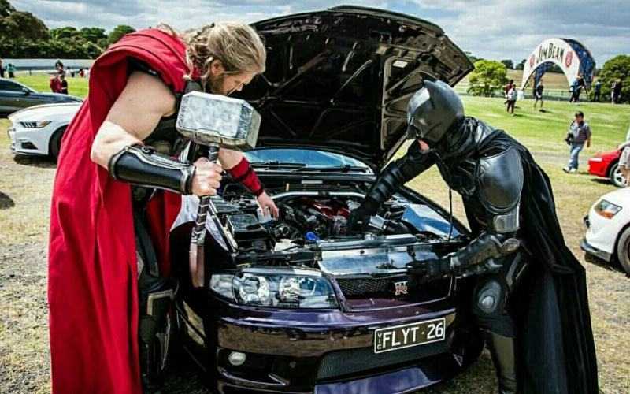

Slide 5


Slide 6
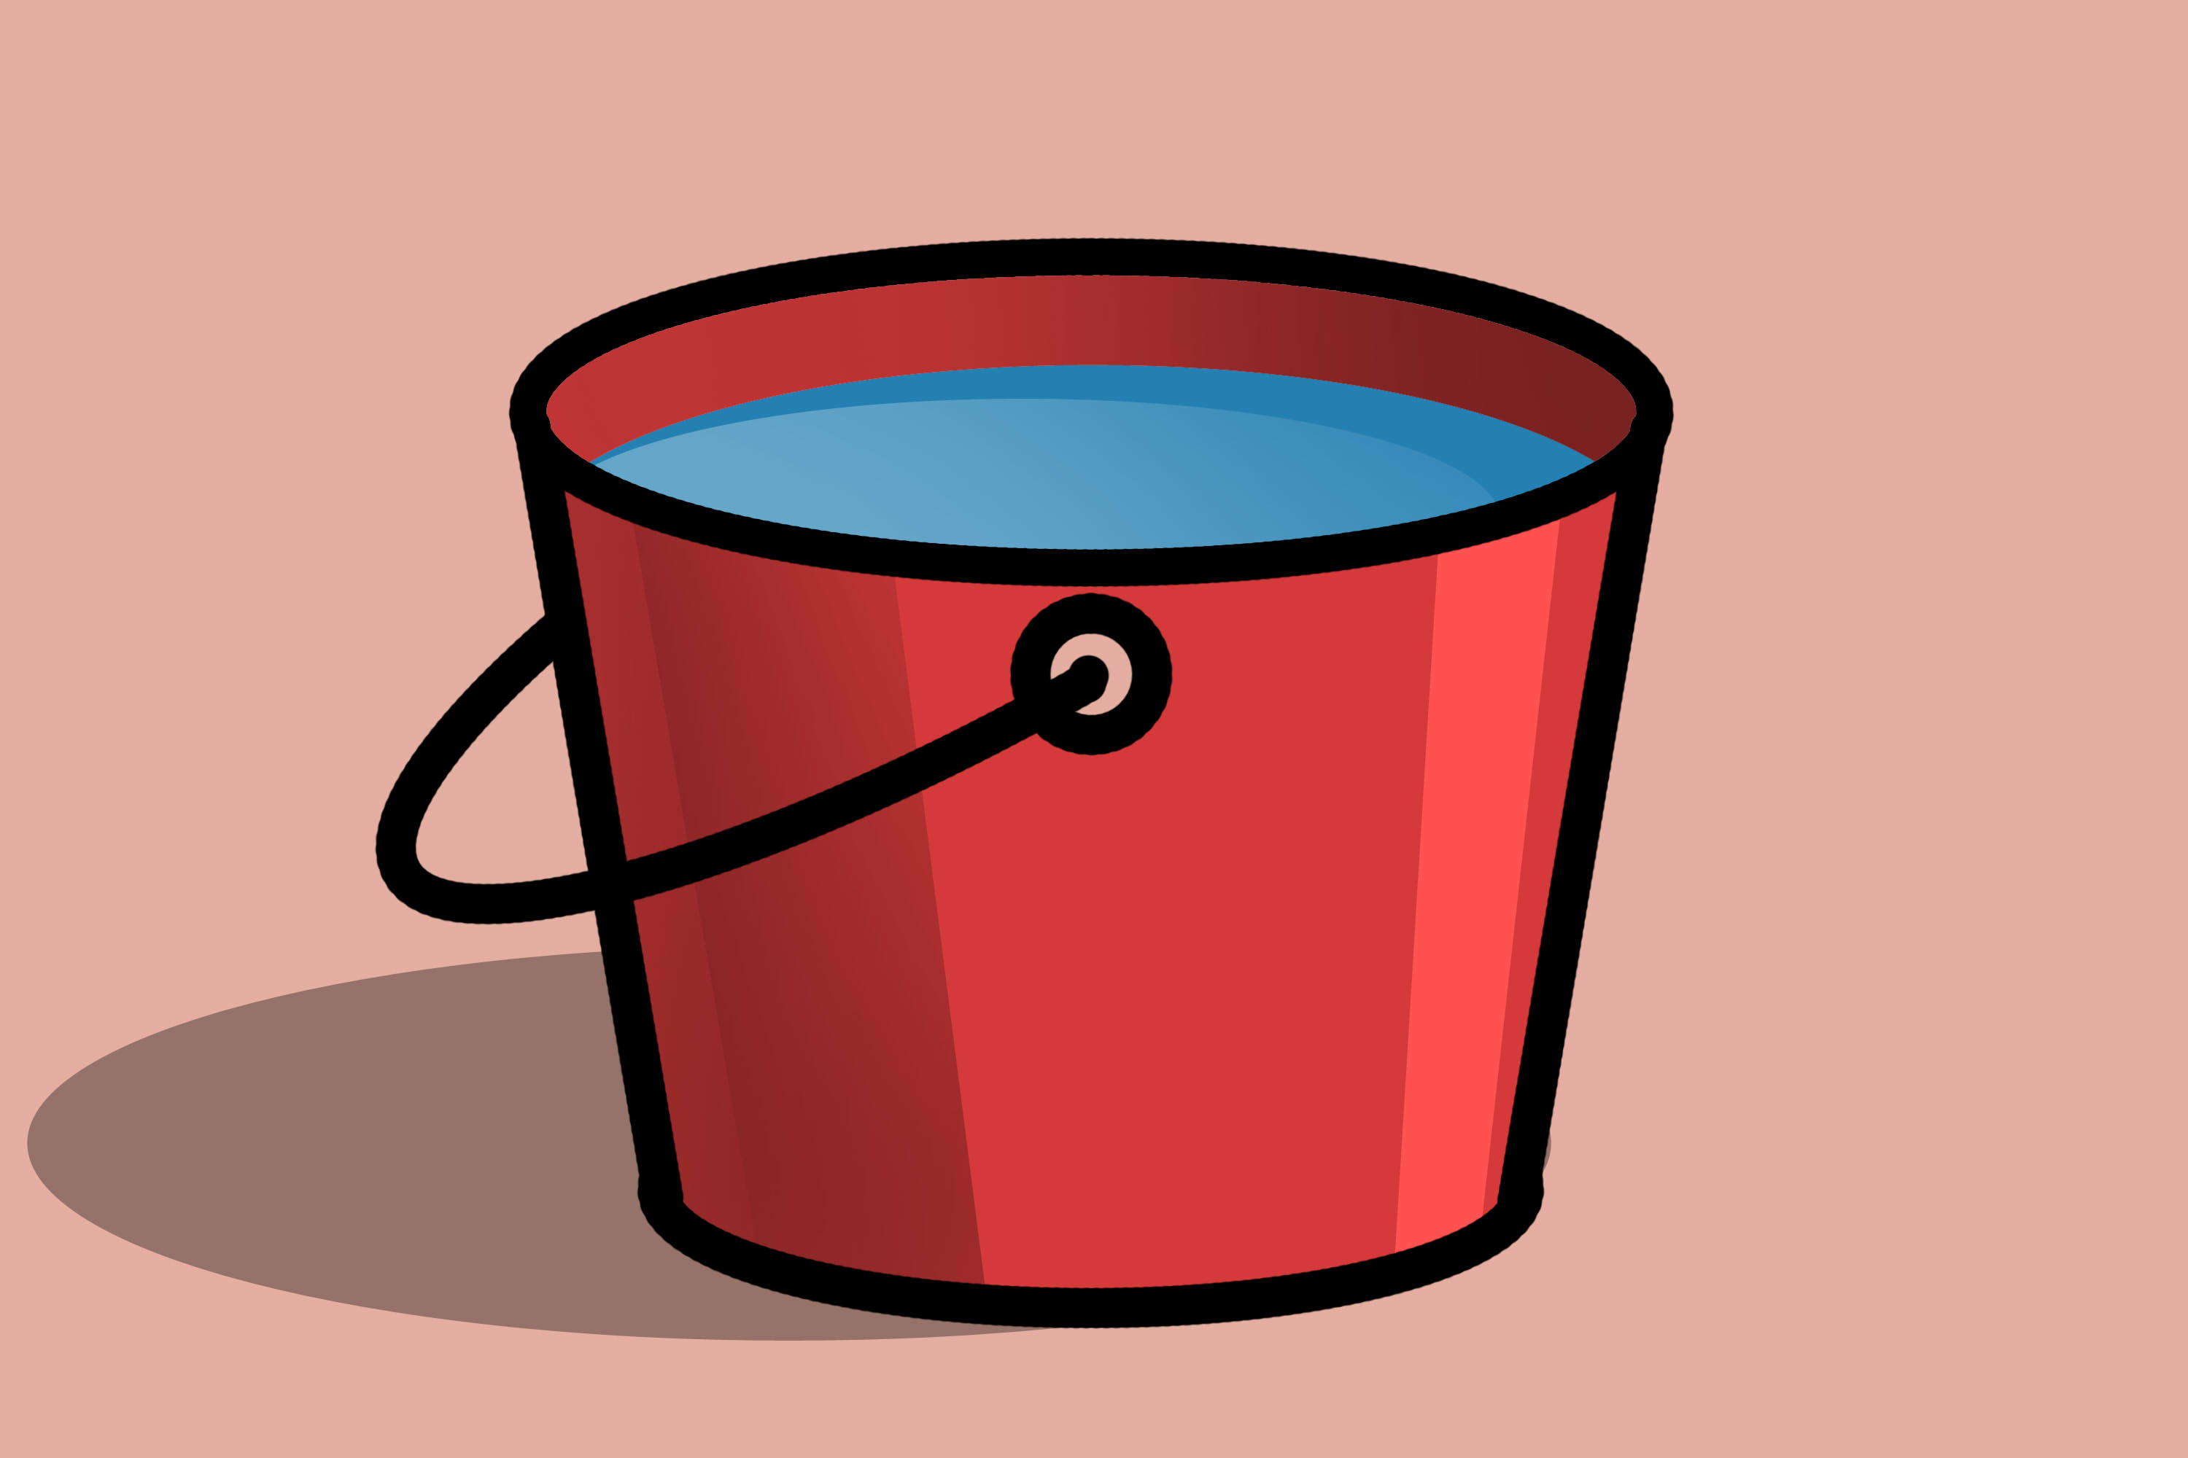

Slide 7


Slide 8
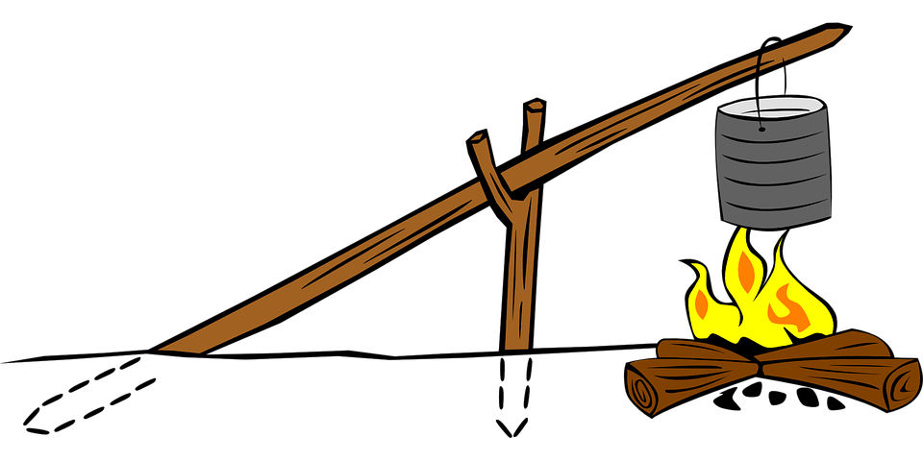

Slide 9
Exam 70-535 Certification Jump Start Dave Burnison Technology Solutions Professional - Azure App Dev Dave.Burnison@Microsoft.com
Azure Compute

Slide 10
Azure Compute
Exam 70-535 Certification Jump Start
Dave Burnison - Microsoft
Azure App Dev TSP – US NCR
dabu@microsoft.com
Notes:
ASM 534
ARM 535

Slide 11
Design Compute Infrastructure (20-25%)
From https://www.microsoft.com/en-us/learning/exam-70-535.aspx
Design solutions using virtual machines
Design VM deployments by leveraging availability sets, fault domains, and update domains in Azure; use web app for containers; design VM Scale Sets; design for compute-intensive tasks using Azure Batch; define a migration strategy from cloud services; recommend use of Azure Backup and Azure Site Recovery
Design solutions for serverless computing
Use Azure Functions to implement event-driven actions; design for serverless computing using Azure Container Instances; design application solutions by using Azure Logic Apps, Azure Functions, or both; determine when to use API management service
Design microservices-based solutions
Determine when a container-based solution is appropriate; determine when container-orchestration is appropriate; determine when Azure Service Fabric (ASF) is appropriate; determine when Azure Functions is appropriate; determine when to use API management service; determine when Web API is appropriate; determine which platform is appropriate for container orchestration; consider migrating existing assets versus cloud native deployment; design lifecycle management strategies
Design web applications
Design Azure App Service Web Apps; design custom web API; secure Web API; design Web Apps for scalability and performance; design for high availability using Azure Web Apps in multiple regions; determine which App service plan to use; design Web Apps for business continuity; determine when to use Azure App Service Environment (ASE); design for API apps; determine when to use API management service; determine when to use Web Apps on Linux; determine when to use a CDN; determine when to use a cache, including Azure Redis cache
Create compute-intensive application
Design high-performance computing (HPC) and other compute-intensive applications using Azure Services; determine when to use Azure Batch; design stateless components to accommodate scale; design lifecycle strategy for Azure Batch
Notes:
As you can see, we have A LOT to cover so please jot down your questions and hold them to the end.
https://www.microsoft.com/en-us/learning/exam-70-535.aspx

Slide 12
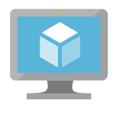
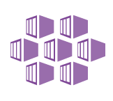
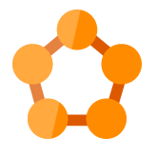


Azure: The Power Of Choice
Compute
Virtual Machines
Container Service
Service Fabric
App Service
Functions
More Control
Focus on the App
Customer-managed
(IaaS)
Platform-managed
(PaaS)
Code-only
(serverless)
Notes:
Azure provides several cloud-based compute offerings to run your application so that you don't have to worry about the infrastructure details.
You can easily scale up or scale out your resources as your application usage grows. Azure offers services that cover the spectrum—from providing infrastructure-as-a-service (IaaS) to give you full control over your application hosting, through platform-as-a-service (PaaS) where the services are hosted for you, to true serverless hosting where all you need to do is write your code.

Slide 13
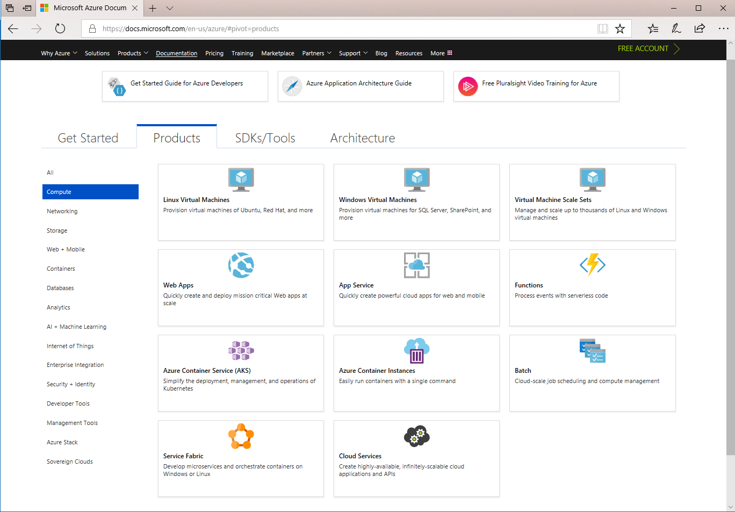
Azure Doc: Compute
https://docs.microsoft.com/en-us/azure/#pivot=products&panel=Compute

Slide 14
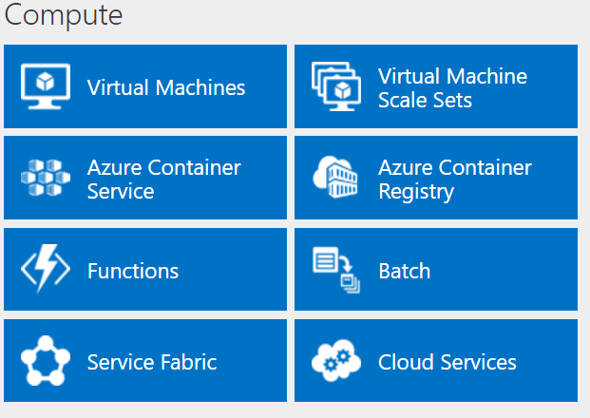
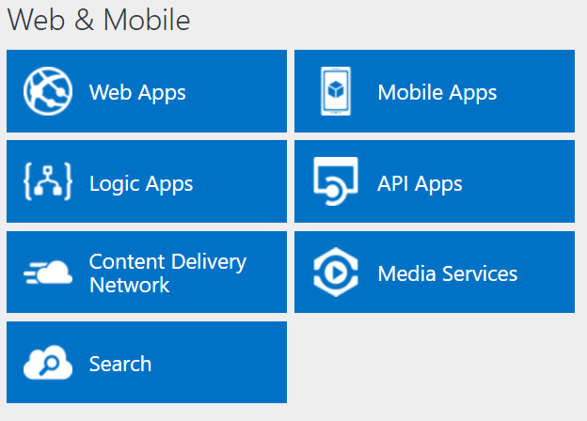
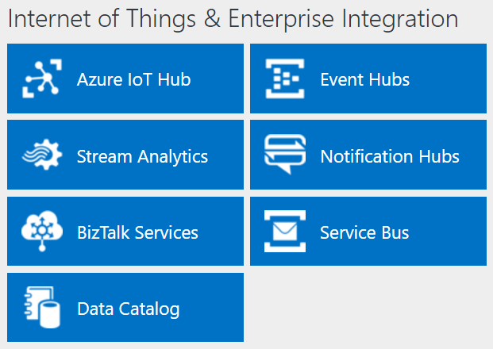
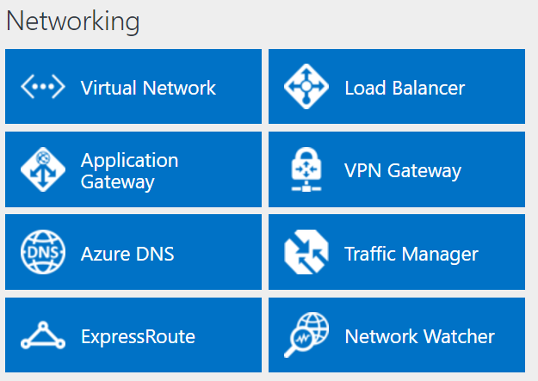
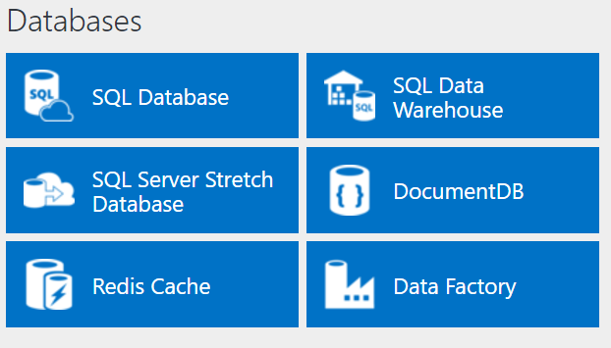
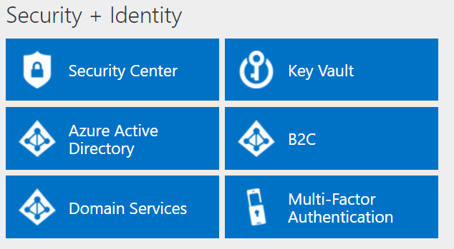
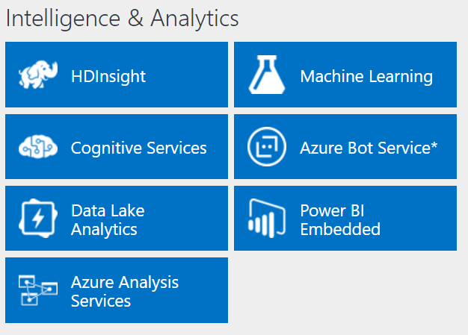
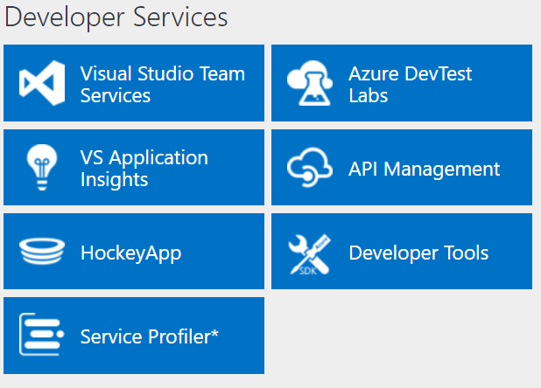
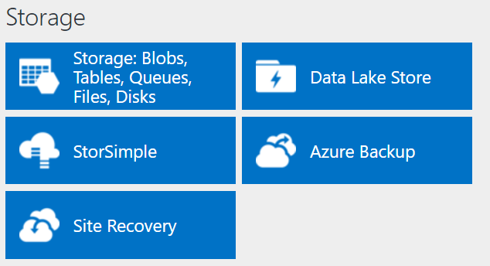
http://azureplatform.azurewebsites.net/
* Preview Services
Notes:
Preview Version 1.7 (2017-04-20)

Slide 15
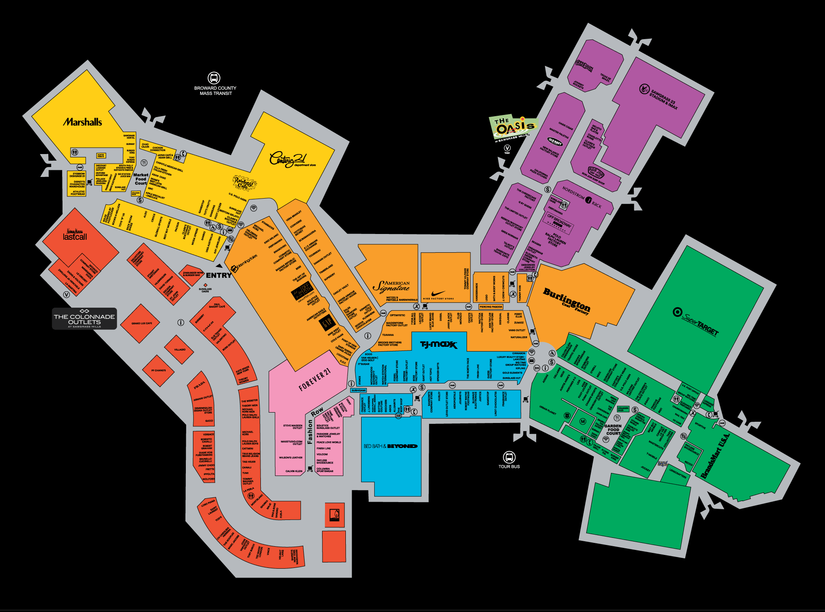
Notes:
Pero… aqui… aqui esta differente!
Alguien ha estado aqui?!
Alguien concoce este lugar?
Este es un centro comercial circa de Miami. Se llama “Sawgrass Mills”.
Yo fui a este lugar una vez. Hace diez anos? No me recuerdo
Si no sabe lo que quiere comprar…
es facil perderse aqui?!
Se necesitan una guia!

Slide 16
Overview & Basics
Storage
Compute
Security & Management
Networking
Data & Analytics
Notes:
No es una problema!
yo seré su guía
Voy a dar un recorrido por el centro comercial del AZURE!
El centro comercial tiene diferentes secciones
Y tambien, Azure tiene diferentes secciones mejor.
Vamos a caminar juntos a los secciones del Azure (centro comercial.)
No vamos a entrar en los detalles de cada servicio. Solo explorarémos los servicios en cada sección para que los conocen.
Despues de este presentacion, ustedes deben conocer Azure mejor!
Y tambien, ustedes deben poder dar un recorrido por lo mismo a sus clientes y sus socios

Slide 17
Compute

Slide 18
Compute
IaaS VMs
VM Scale Sets
Batch
Logic Apps
Functions
App Service
Azure Container Service
Azure Container Instances
Service Fabric
Cloud Services
SERVERS!
SERVERLESS!
https://aka.ms/comparecompute

Slide 19
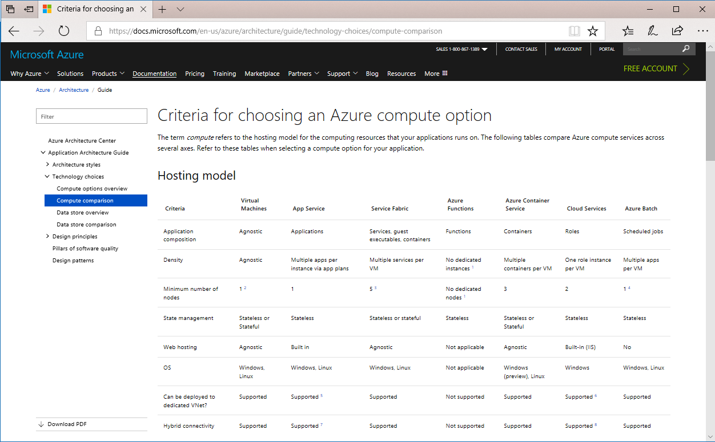
Azure Doc: Compare Compute Options
https://aka.ms/comparecompute

Slide 20
Azure Resource Manager (ARM)
All services offered as ARM resources
Consistent model for creating/managing Azure resources
Based on declarative templates
Resources are managed in resource groups
Deployed together
Managed together
Provides RBAC support
Notes:
Demo: Resource Explorer
SIMILAR SECURITY OR APPLICATION LIFECYCLE REQUIREMENTS

Slide 21
Azure Resource Manager Terminology
Resource
A manageable unit of Azure infrastructure
Examples: virtual machine, load balancer, storage account
Resource provider
A service that allows for creation and management of resources
Examples: Compute Resource Provider, Storage Resource Provider
Resource manager template
A declarative template for describing a resource group

Slide 22
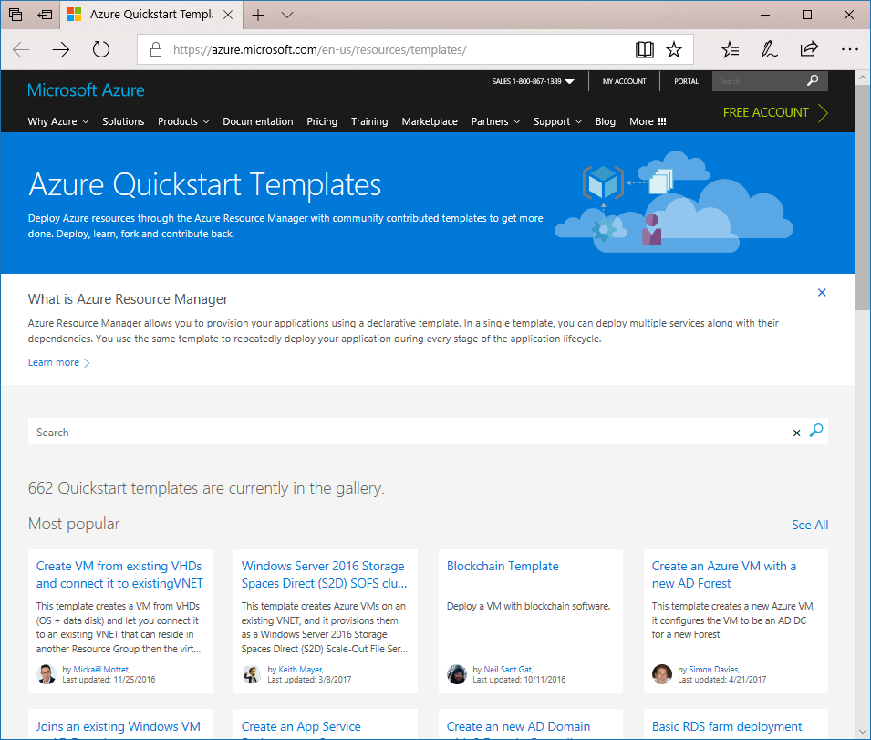
Reusable ARM Templates
https://azure.microsoft.com/en-us/resources/templates/

Slide 23
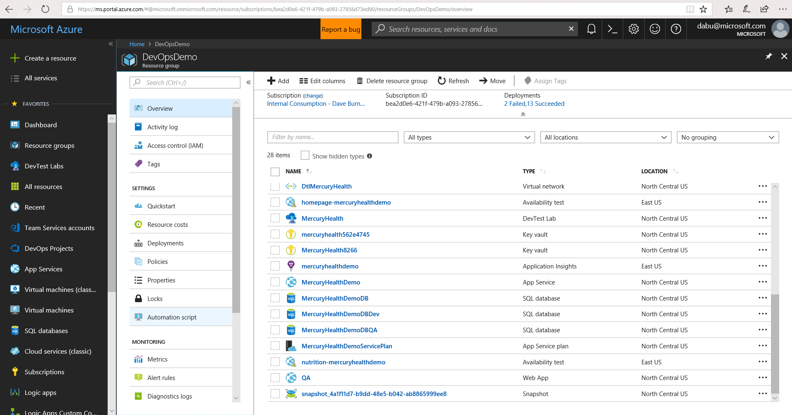
Notes:
SOMETIMES YOU JUST WANT TO DEPLOY VISUALLY
YOU CAN TEMPLATIZE DEPLOYMENTS AND SPECIFY VARIABLES

Slide 24
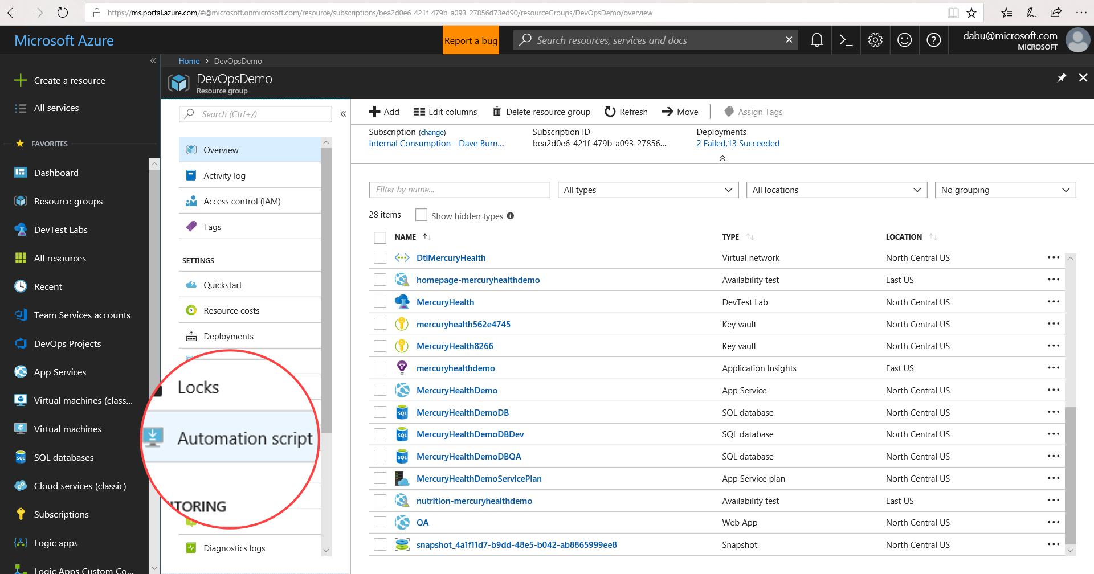

Slide 25
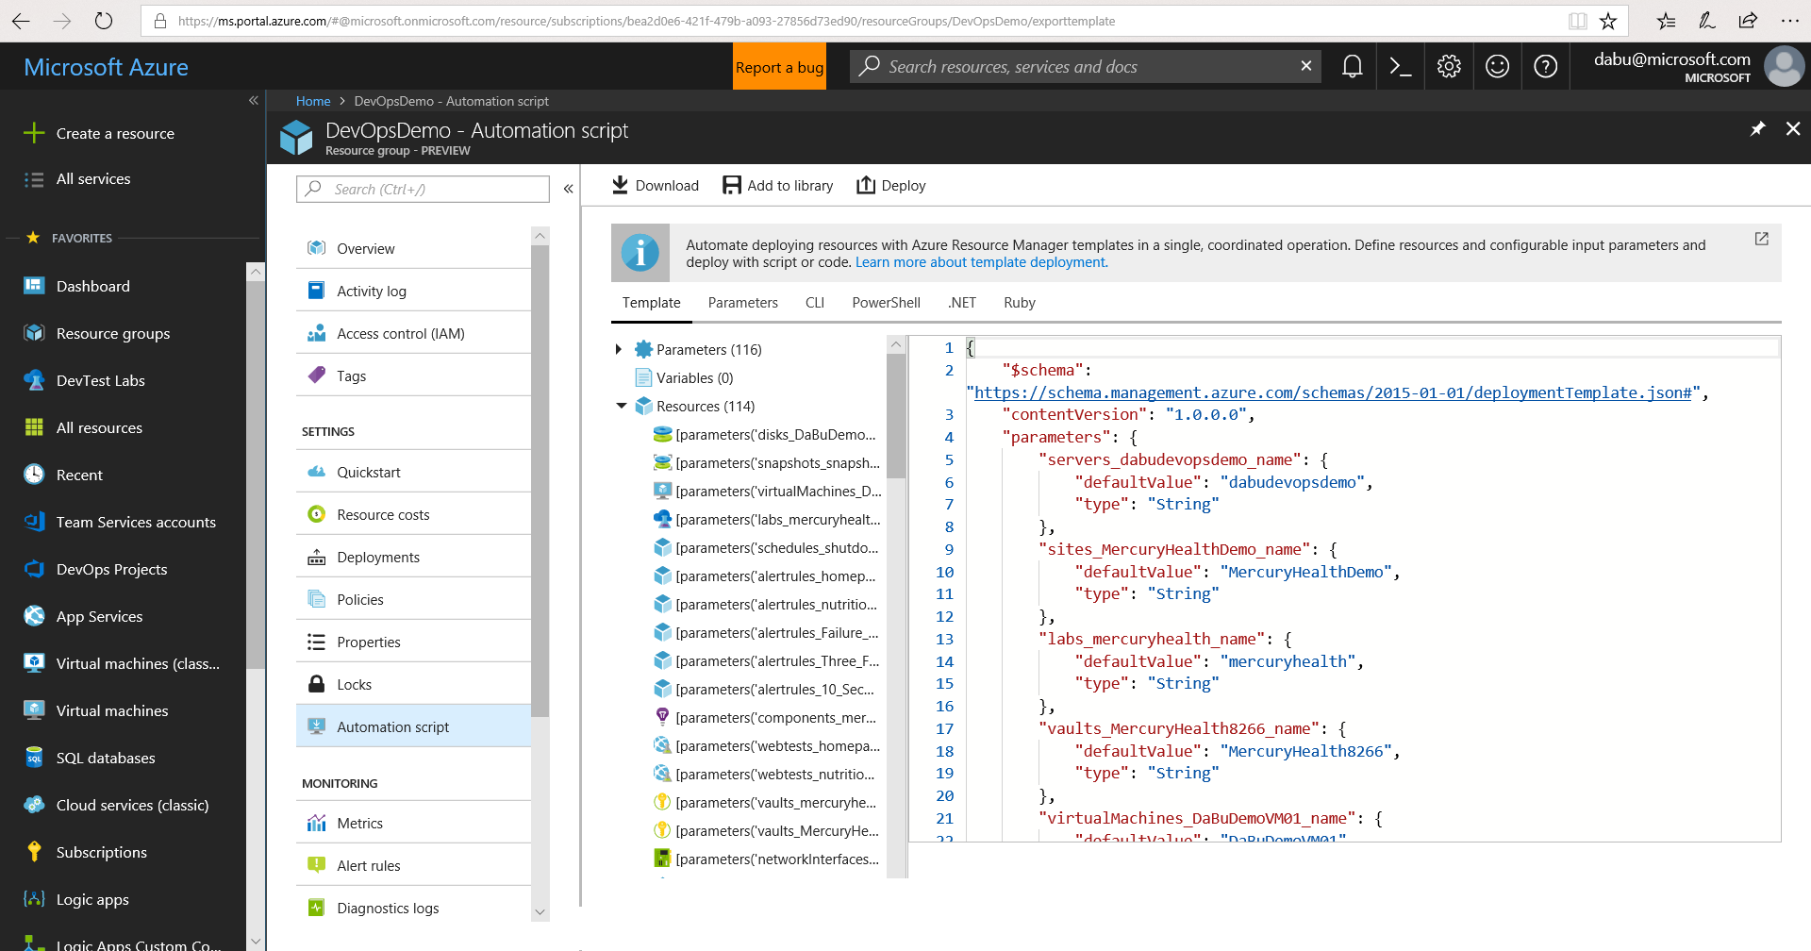
Notes:
JENKINS, OCTOPUS, RELEASE MANAGEMENT. PICK YOUR CODE, PICK YOUR TASK.

Slide 26
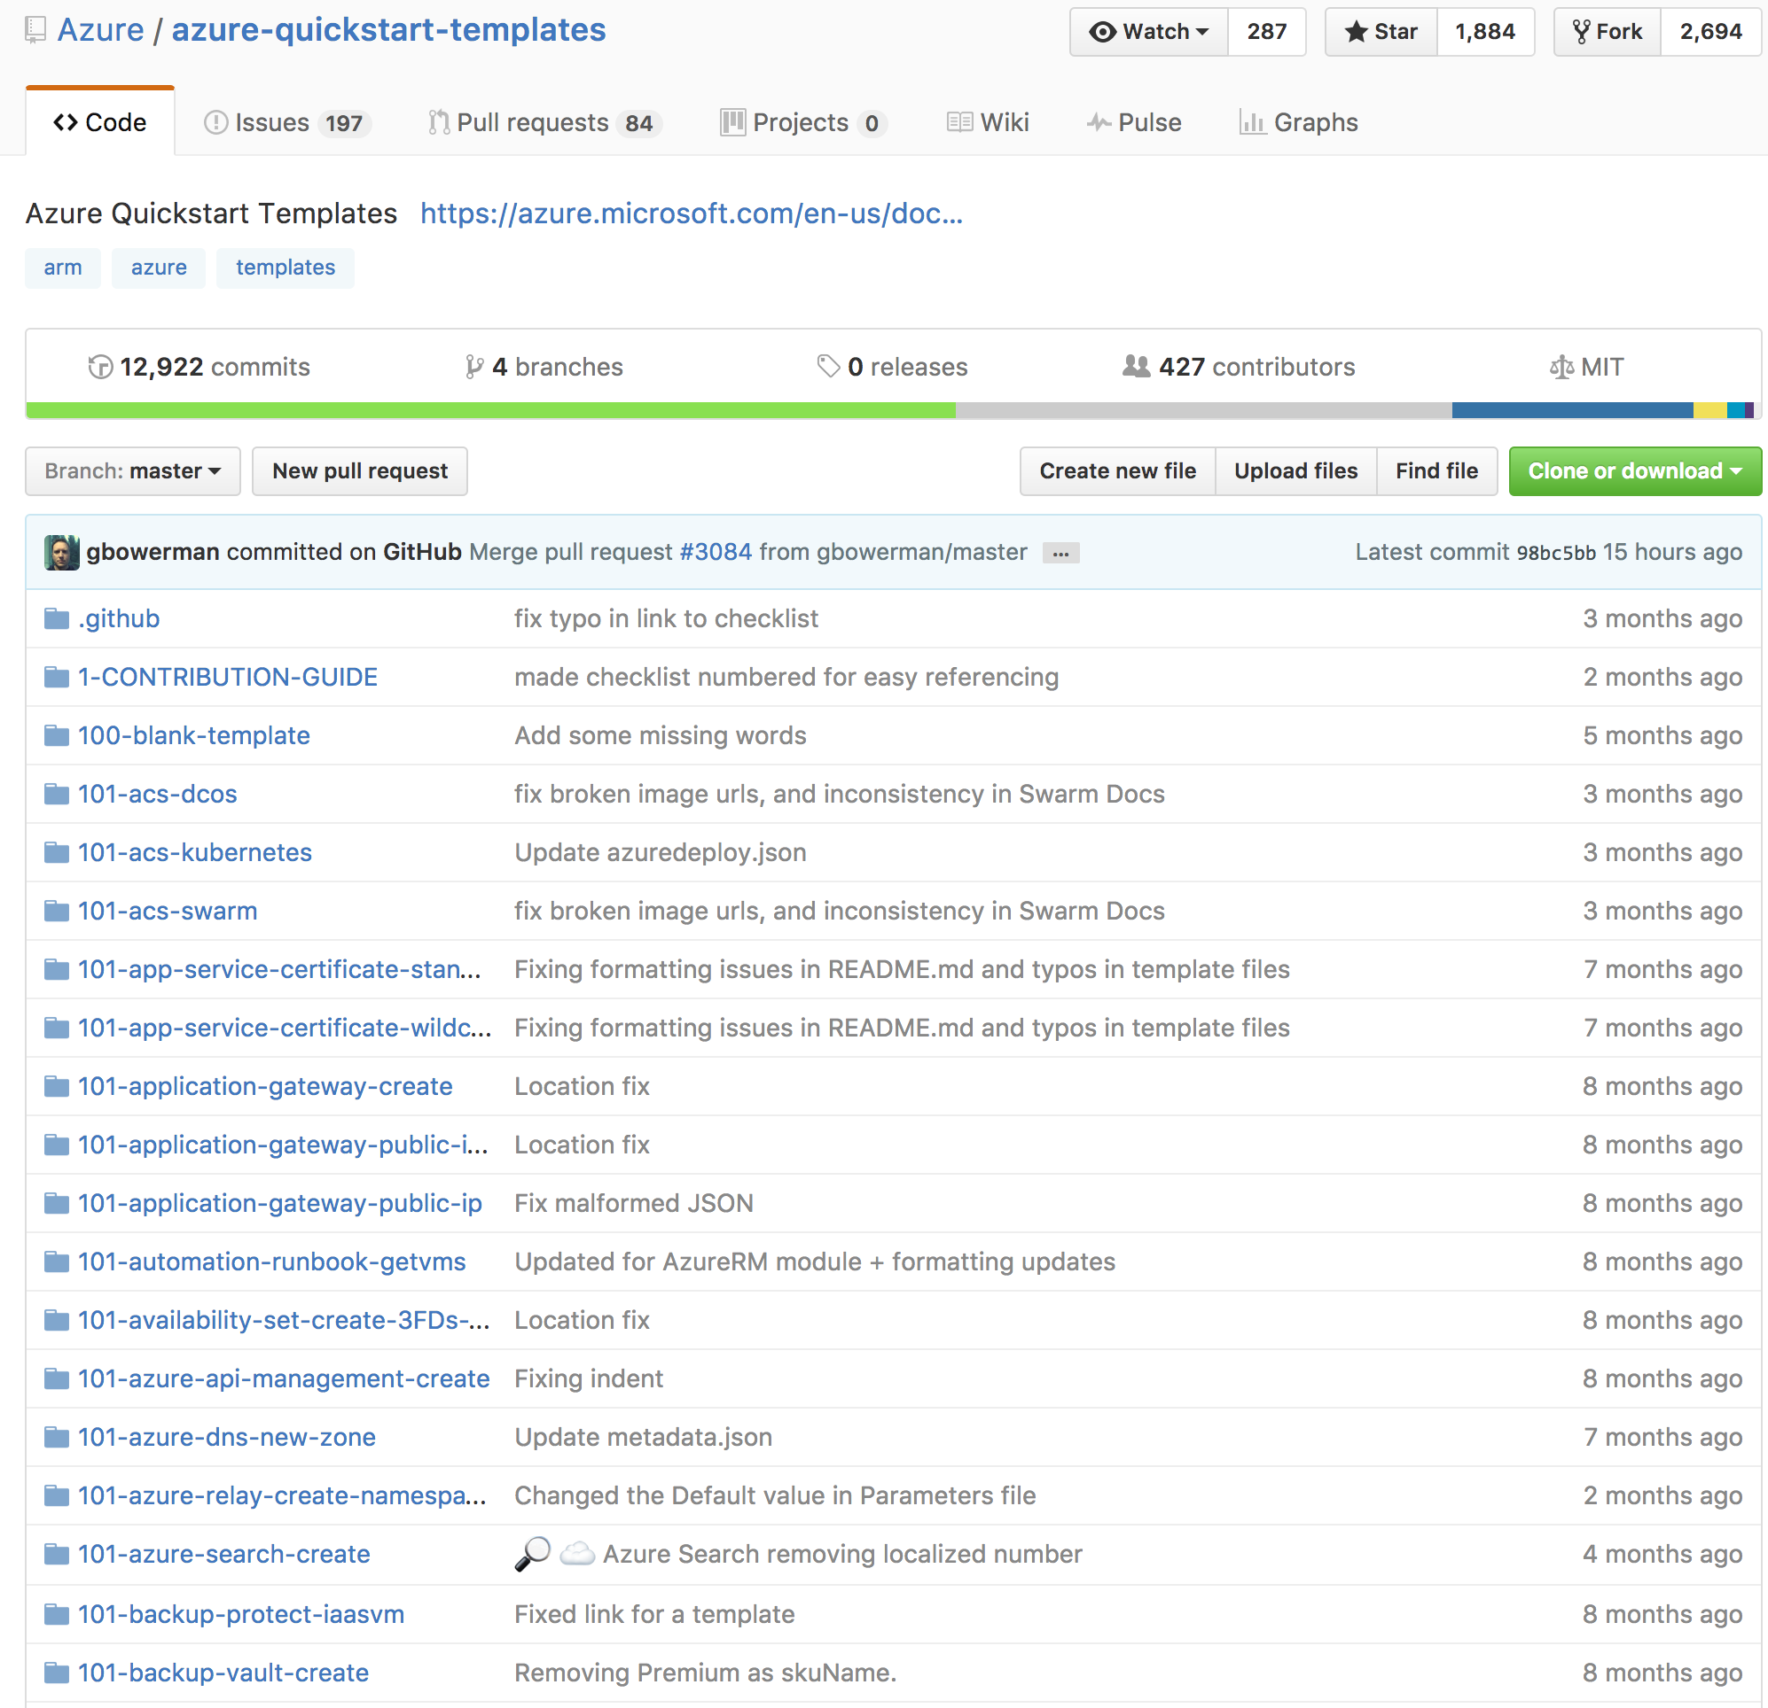
Reusable ARM templates
A declarative template for describing a resource group
Community offered or Build your own
Learn about template here:
https://azure.microsoft.com/en-us/resources/templates/
Notes:
Demo Azure getting started templates

Slide 27
Azure: The Power Of Choice
Application Hosting (today)
Virtual Machines
Customer-managed
(IaaS)

Slide 28
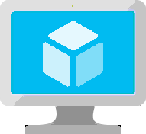
Virtual Machines
Ubuntu, Red Hat, Windows, SUSE, CoreOS
DevOps Extensions with Chef and Puppet
Multiple sizes
Hundreds of items in marketplace
Notes:
Really the basic building block of all other compute services
Valuable for cases where you’re simply lifting-and-shifting an existing workload to the cloud and want to maintain the existing topology.
Huge variety of OS images available, including all the popular Linux distros
Support for many popular configuration tools, including Chef and Puppet.
Available in many different sizes to fit your workload, including the recently announced N-series which offer Nvidia GPUs for graphically intense workloads.
And of course, since VMs make up the basic building blocks in our Compute story, many people have built interesting things out of them, which are available in the marketplace…

Slide 29
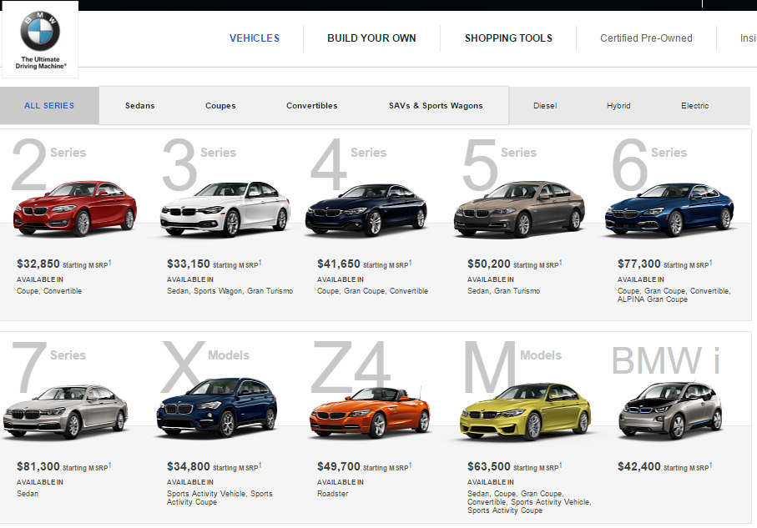
Notes:
Tiers – Define a set of capabilities that all VM sizes within the tier provide
Standard Tier - Offers the most flexibility. Supports all virtual machine configurations and features.
Basic Tier - An economical option for development workloads, test servers, and other applications that don't require load balancing, auto-scaling, or memory-intensive virtual machines.
Series – Define a set of capabilities based on the underlying host hardware the virtual machines run on
A Series – The first series of Azure IaaS virtual machines
D Series – Feature solid state drives (SSDs) and faster processors than the A-series and are also available for web or worker roles in Azure Cloud Services. This series is ideal for applications that demand faster CPUs, better local disk performance, or higher memories.
Size – Define a combination of CPU, RAM, and Disk
Example size: A2 - 2 CPU, 3.50 GB RAM, 135.00 GB Disk

Slide 30
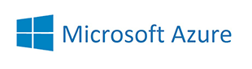
Introducing: The 2017 VM Series…
Notes:
Tiers – Define a set of capabilities that all VM sizes within the tier provide
Standard Tier - Offers the most flexibility. Supports all virtual machine configurations and features.
Basic Tier - An economical option for development workloads, test servers, and other applications that don't require load balancing, auto-scaling, or memory-intensive virtual machines.
Series – Define a set of capabilities based on the underlying host hardware the virtual machines run on
A Series – The first series of Azure IaaS virtual machines
D Series – Feature solid state drives (SSDs) and faster processors than the A-series and are also available for web or worker roles in Azure Cloud Services. This series is ideal for applications that demand faster CPUs, better local disk performance, or higher memories.
Size – Define a combination of CPU, RAM, and Disk
Example size: A2 - 2 CPU, 3.50 GB RAM, 135.00 GB Disk

Slide 31

Azure VM Sizes
A
D
Dv2
G
Av2
Lowest Price
SSD Storage Fast CPUs
New generation of D family VMs
High memory and
Large SSDs
New A-Series
F
NC
NV
H
L
SAP
Compute Intensive
NVIDIA GPUs
K80 Compute
NVIDIA GPUs
M60 Visualization
Fastest CPU
IB Connectivity
Large SSDs
SAP Large Instances
Soon
Soon
Soon
Soon
ND
NCv2
Dv3
Ev3
Deep Learning
NVIDIA P40s
New gen of NC
NVIDIA P100s
New generation of D family
High memory
Notes:
N SERIES ONE OR MORE VIDEO CARDS
M SERIES UP TO 4TB RAM
CAN CHANGE FROM D TO Dv2 FOR EXAMPLE. NOT ALWAYS POSSIBLE TO CHANGE BETWEEN SERIES.

Slide 32
VM Sizes
Type | Sizes | Description
General purpose | B (Preview), Dsv3, Dv3, DSv2, Dv2, DS, D, Av2, A0-7 | Balanced CPU-to-memory ratio. Ideal for testing and development, small to medium databases, and low to medium traffic web servers.
Compute optimized | Fs, F | High CPU-to-memory ratio. Good for medium traffic web servers, network appliances, batch processes, and application servers.
Memory optimized | Esv3, Ev3, M, GS, G, DSv2, DS, Dv2, D | High memory-to-CPU ratio. Great for relational database servers, medium to large caches, and in-memory analytics.
Storage optimized | Ls | High disk throughput and IO. Ideal for Big Data, SQL, and NoSQL databases.
GPU | NV, NC | Specialized virtual machines targeted for heavy graphic rendering and video editing. Available with single or multiple GPUs.
High performance compute | H, A8-11 | Our fastest and most powerful CPU virtual machines with optional high-throughput network interfaces (RDMA).
Notes:
B series - https://buildazure.com/2017/09/11/more-affordable-azure-vms-with-burstable-b-series/
Determine Cores, RAM, ACUs, Disks, NICs, Network Speed, Temporary Storage, SSD support
High level categories:
Acu helps normalize cpu perf.. D&f have same acu

Slide 33
VM Azure Compute Unit (ACU)
SKU Family | ACU \ vCPU
A0 | 50
A1-A4 | 100
A5-A7 | 100
A1_v2-A8_v2 | 100
A2m_v2-A8m_v2 | 100
A8-A11 | 225*
D1-D14 | 160
D1_v2-D15_v2 | 210 - 250*
DS1-DS14 | 160
DS1_v2-DS15_v2 | 210-250*
D_v3 | 160-190* **
Ds_v3 | 160-190* **
E_v3 | 160-190* **
Es_v3 | 160-190* **
F1-F16 | 210-250*
F1s-F16s | 210-250*
G1-G5 | 180 - 240*
GS1-GS5 | 180 - 240*
H | 290 - 300*
L4s-L32s | 180 - 240*
M | 160-180**
Provide a way of comparing compute (CPU) performance across Azure SKUs
Not all Azure Cores are created equal
A1 Core != F1 Core
Compare compute (CPU) performance across SKUs.
Notes:
Not all Azure Cores are created equal
A1 Core != F1 Core
Compare compute (CPU) performance across SKUs.
https://docs.microsoft.com/en-us/azure/virtual-machines/windows/acu
Azure Compute Unit (ACU) to provide a way of comparing compute (CPU) performance across Azure SKUs. This will help you easily identify which SKU is most likely to satisfy your performance needs. ACU is currently standardized on a Small (Standard_A1) VM being 100 and all other SKUs then represent approximately how much faster that SKU can run a standard benchmark.
ACUs marked with a * use Intel® Turbo technology to increase CPU frequency and provide a performance boost. The amount of the boost can vary based on the VM size, workload, and other workloads running on the same host.+
**Hyper-threaded.

Slide 34
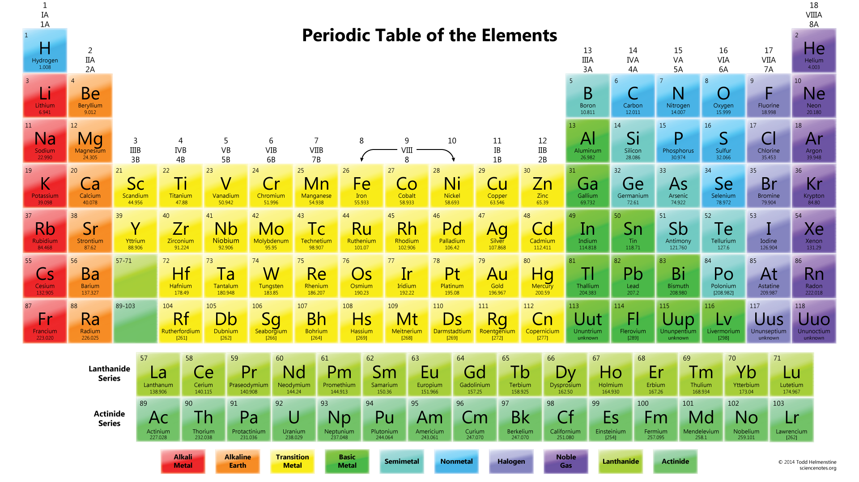
The Fundamental Element of Azure

Slide 35
The Fundamental Element of Azure
St
1
Storage
Notes:
Flexibility at multiple levels -
Access level – hot storage or cold storage
Tier
Abstraction level – files, disks
Disk level – spindle, SSD, managed
Redundancy level – LRS, ZRS, GRS, RAGRS

Slide 36
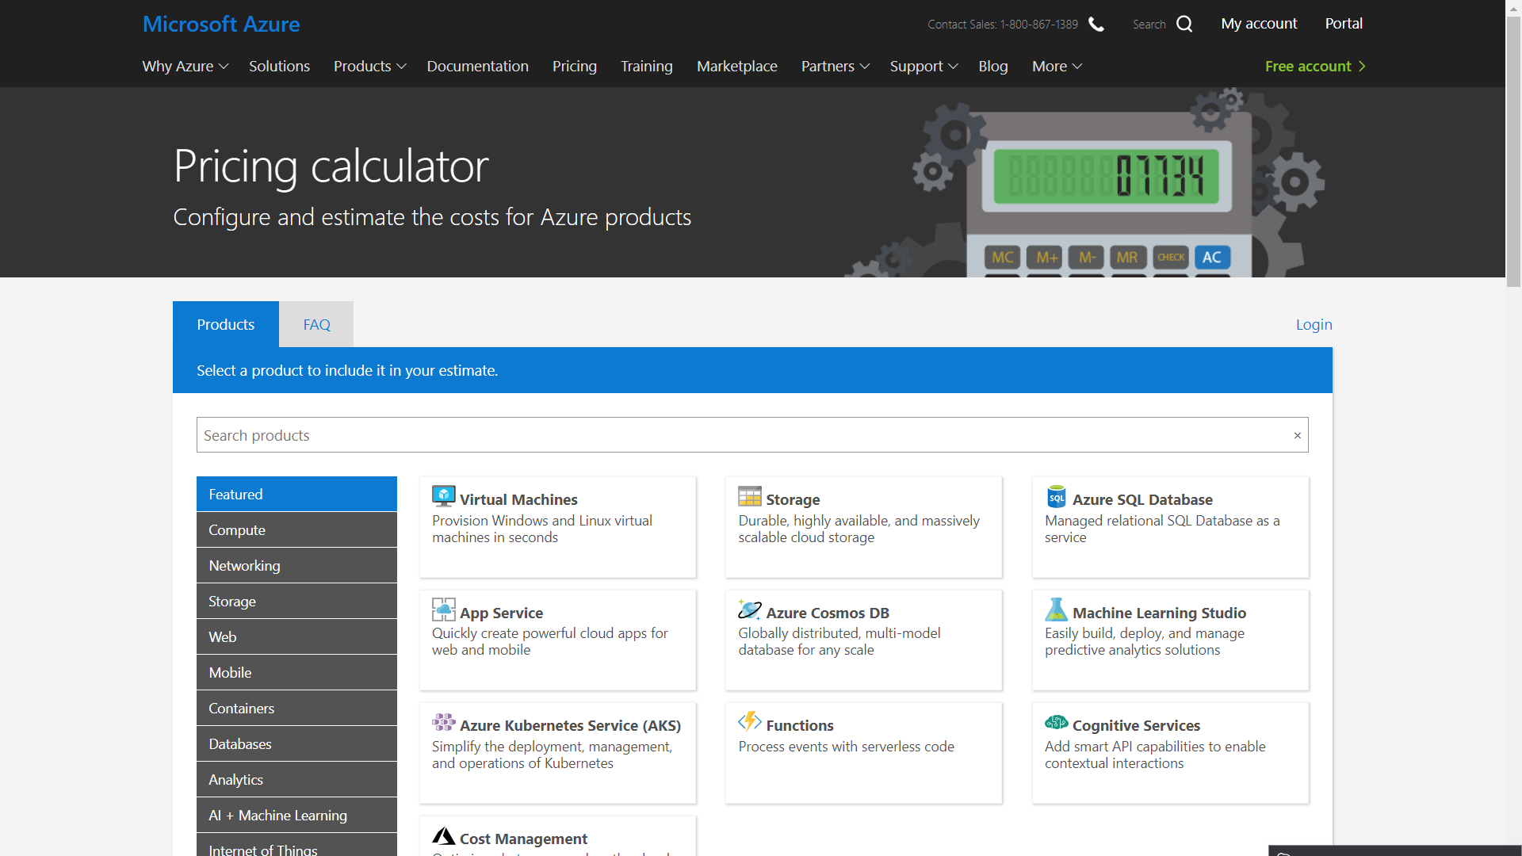
Notes:
https://azure.microsoft.com/en-us/pricing/calculator/

Slide 37
VM Disks
OS Disk (attached via SATA)
VHD based
Persists
Separate storage cost
Temporary Disk
Doesn’t persist - SSD
No Separate storage cost
Data Disk (SCSI)
VHD based
Persists
Separate storage cost
Current Max Data Disk Size: 4,095 GB
Notes:
https://docs.microsoft.com/en-us/azure/storage/storage-premium-storage#scalability-and-performance-targets
The temporary disk is labeled as the D: drive by default and it used for storing pagefile.sys

Slide 38
 | Azure Premium Disk | Azure Standard Disk
Disk Type | Solid State Drives (SSD) | Hard Disk Drives (HDD)
Overview | SSD-based high-performance, low-latency disk support for VMs running IO-intensive workloads | HDD-based cost effective disk support for Dev/Test VM scenarios
Scenario | Production and performance sensitive workloads | Dev/Test, non-critical, Infrequent access
Disk Size | P4: 32 GB (Managed Disks only) P6: 64 GB (Managed Disks only) P10: 128 GB P20: 512 GB P30: 1024 GB P40: 2048 GB P50: 4095 GB | Unmanaged Disks: 1 GB – 4 TB (4095 GB) Managed Disks: S4: 32 GB S6: 64 GB S10: 128 GB S20: 512 GB S30: 1024 GB S40: 2048 GB S50: 4095 GB
Max Throughput per Disk | 250 MB/s | 60 MB/s
Max IOPS per Disk | 7500 IOPS | 500 IOPS
Notes:
IN PREVIEW—AZURE STANDARD SSD—5000 IOPS 200MB THROUGHOUT –HALF THE PRICE OF PREMIUM
IOPS DEPEND ON VM SIZE
Managed disk - https://docs.microsoft.com/en-us/azure/virtual-machines/windows/managed-disks-overview
https://docs.microsoft.com/en-us/azure/storage/common/storage-premium-storage
Unmanaged disks
The original method is to use unmanaged disks. In an unmanaged disk, you manage the storage accounts that you use to store the virtual hard disk (VHD) files that correspond to your VM disks. VHD files are stored as page blobs in Azure storage accounts.
Managed disks
When you choose Azure Managed Disks, Azure manages the storage accounts that you use for your VM disks. You specify the disk type (Premium or Standard) and the size of the disk that you need. Azure creates and manages the disk for you. You don't have to worry about placing the disks in multiple storage accounts to ensure that you stay within scalability limits for your storage accounts. Azure handles that for you.
Throughput and IOPS are lower for smaller disks

Slide 39
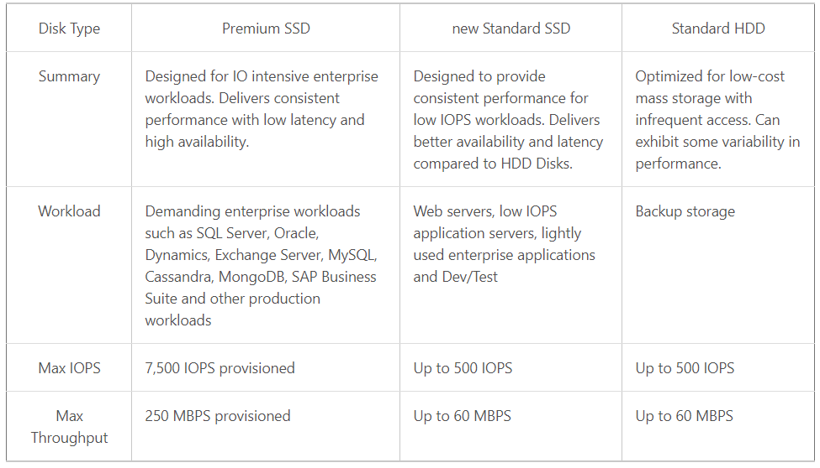

Slide 40
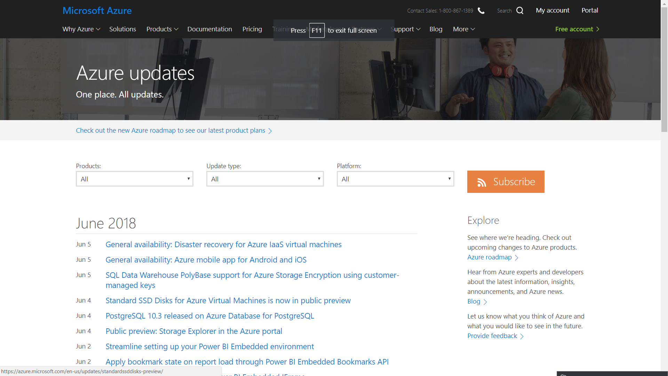
Notes:
https://azure.microsoft.com/en-us/updates/

Slide 41
VM Recommendations
Premium Storage for Production Workloads (Storage SLAs)
Choose a VM Size that works with premium storage for production
Use Managed Disks over Unmanaged Disks
Scaling Up/Down is just resizing the VM
Scaling In/Out – the VMs should be in an availability set
Use VM reboot logs to determine if VM was rebooted by planned maintenance
Use snapshots to prevent accidental data loss
Enable VM diagnostics for production (includes boot diagnostics)
Stopped VMs are still charged for use. VMs need to be deallocated to stop charges. Stopping through OS does not deallocate! Stop with portal or CLI.
Notes:
MICROSFOT MOVING INTERNALLY TO MANAGED DISKS
https://docs.microsoft.com/en-us/azure/architecture/reference-architectures/virtual-machines-linux/single-vm

Slide 42
High Availability & Disaster Recovery in Azure
High Availability
Availability within a single Azure region or datacenter*
Expectation is little or no downtime (99.x % uptime)
Disaster Recovery
Recover into a secondary datacenter if outage in primary datacenter
Acceptable downtime has a greater range
Quantified by Recovery Time Objective (RTO) & Recovery Point Objective (RPO)
Notes:
POD = 990-998 NODES
MULTIPLE NODES MAKE UP A DATACENTER
MULTIPLE DATACENTERS MAKE UP A REGION
THREE DATACENTERS IN A ZONE
MS DESIGNS DATACENTERS
OPEN COMPUTE SPECIFICATIONS RELEASED
VENDERS BID, MS BUYS
NO LOGOS, SAVING 2CENTS PER BOX
HP THROWS THEM IN FOR FREE
70% OF HDS CAN FAIL IN A POD BEFORE THE POD IS REPLACED
NO WAY THAT CUSTOMERS CAN RUN THEIR DATACENTERS CHEAPER
EVERY REGION HAS A PAIRED (SISTER) REGION
NEW SCOTLAND UNDERWATER DATACENTER—NOT ENOUGH LAND NEAR THE POPULATION
ROBOT PICKED UP UNDERWATER CABLE AND CONNECTED IT BEFORE LOWERING DATACENTER 130’
MS OWNS SECOND LARGEST DARK FIBER IN THE WORLD
GOOGLE #1
FACEBOOK #3
ZERO PEOPLE WORK IN THE DATACENTER
NETWORK AND POWER CONNECTION REQUIRES AN EMPLOYEE
ASR = AZURE TO AZURE SITE RECOVERY
MUST COORDINATE WITH ASE (APP SERVICE ENVIRONMENT)
“An App Service Environment is a Premium service plan option of Azure App Service that provides a fully isolated and dedicated environment for securely running Azure App Service apps at high scale, including Web Apps, Mobile Apps, and APIApps.”
Different folks may have their own definitions for “high availability” and “disaster recovery”.
Let’s take some time to review what these terms mean specifically in Azure.
ANIMATE!!!
ANIMATE!!!
Availability is typically the amount of time a service is available (or “up”) within the context of a single datacenter or region.
ANIMATE!!!
Most Azure services are backed with an SLA that is quantified by 99 point some number of 9s % availability per month.
In general, when we say a service is “highly available” in Azure, the expectation is that there is little or no downtime for that service within the datacenter
ANIMATE!!!
ANIMATE!!!
With Disaster recovery, we are talking about the ability to recover your application into a secondary datacenter in the event of a datacenter outage. (usually somewhere far away – at least 500 miles)
ANIMATE!!!
When this happens, the amount of acceptable downtime may have a greater range… from seconds, to minutes, hours, or even a day!
It all depends on what type of Disaster Recovery plan you have in place. The costs vary widely ranging from active deployments in 2 datacenters to just having backups in a secondary datacenter that you must recovery from.
ANIMATE!!!!
Choosing a disaster recovery plan depends on what the business requirements are for RTO & RPO.
RTO – Acceptable time to recover.
RPO – Acceptable amount of data that can be lost

Slide 43
Defining Disaster Recovery within Azure
Disaster recovery is being able to recover your application into another Azure datacenter
Keywords:
RTO: Recovery Time Objective
RPO: Recovery Point Objective
Options range from:
Complete active/active deployment in multiple datacenters
Active/Passive deployment in multiple datacenters
Active deployment in one datacenter, with backups stored in 2nd datacenter

Slide 44
Understanding Azure VM Availability Single VM
Azure SLA guarantees no data loss, 99.9% uptime SLA*
Subject to un-planned maintenance events due to physical failures
If VM becomes unavailable, Azure migrates VM and restarts in another host
~10-15 minutes to complete this process

Slide 45
Understanding Azure VM Availability Single VM
Azure SLA guarantees no data loss, 99.9% uptime SLA*
Subject to un-planned maintenance events due to physical failures
If VM becomes unavailable, Azure migrates VM and restarts in another host
~10-15 minutes to complete this process
Subject to planned maintenance events due to host OS servicing
All VMs on host are shut down.
Host OS is serviced and rebooted
All VMs on host are restarted
~10-15 minutes to complete this process
Subject to in-memory planned maintenance events
All VMs on host are paused, Host patched, VMs un-paused. 30 seconds downtime
Notes:
PREMIUM DISKS ONLY
MARK RUSSINOVITCH STORY. GUY WENT TO DATA CENTER TO REPLACE UPS WITH SIX SCREWS. THREE PAIRS. ENTIRE POD WENT DOWN.

Slide 46
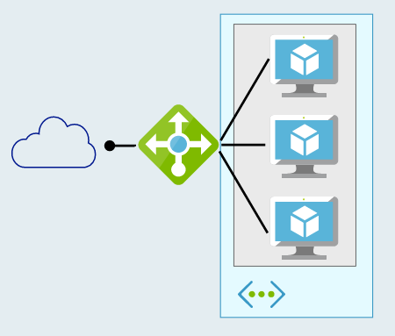
Defining High Availability 2 or more Azure VMs
Multiple VMs can be configured in an “availability set”
Workload is load balanced across the VMs
Azure SLA: 2 (or more) VMs in Availability Set:
99.95% (<22 min downtime p/month)
Includes
Planned downtime due to host OS servicing
Unplanned downtime due to physical failures
Doesn’t include servicing of guest OS or software inside (e.g. SQL)
Notes:
TRIAL FAILOVER TO SINGAPORE FOR EXAMPLE. HAVE VM LIVING IN SINGAPORE—ONLY CHARGED FOR COMPUTE. DO A TEST FAILOVER TO SINGAPORE, THEN YOU’RE CHARGED FOR COMPUTE, ETC DURING TRIAL FAILOVER. AT END OF TEST YOU’LL BE PROMPTED TO ALLOW MS TO CLEAN UP THE TEST FAILOVER RESOURCES
BY THE WAY, AZURE CAN BE USED FOR AS NEEDED STORAGE FOR OTHER APPS
IN AN AVAILABILITY SET, UPTIME SLA GOES UP

Slide 47
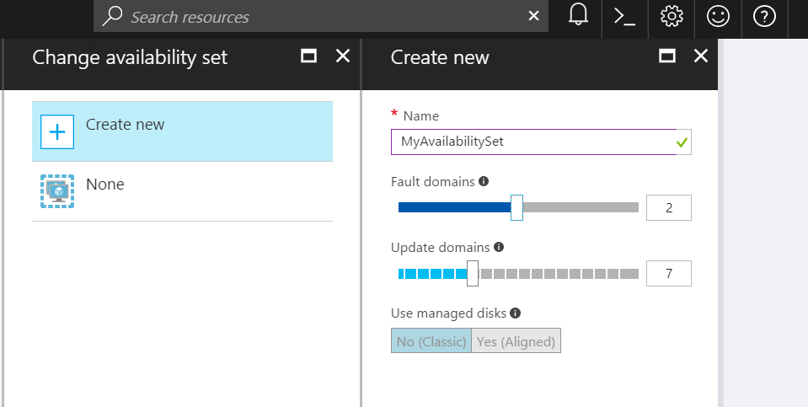
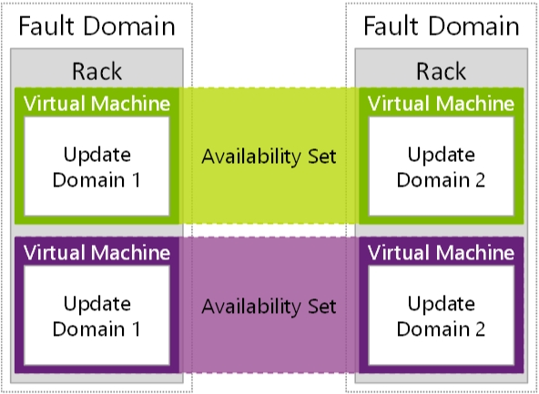
Availability Sets
Availability Sets are for Unplanned & Planned Maintenance
Fault Domains (2 default, some regions allow 3)
Upgrade Domains (5 default, 1-20 allowed)
Front with Load Balancer, App Gateway
Notes:
DON’T PUT ONLY ONE VM IN AN AVAILABILITY SET. MICROSOFT ASSUMES YOU HAVE AT LEAST TWO VMS PER SET AND WILL NOT NOTIFY YOU BEFORE REBOOTING FOR PATCHING. NO COST TO THE AVAILABILITY SET ITSELF, JUST THE RESOURCES WITHIN THE SET.
SERVER FARM IDEA. VMS ARE IDENTICAL IN TERMS OF WHAT’S RUNNING ON THEM. THEY COULD HAVE DIFFERENT SIZES.
VMS WITHIN AN AVAILABILITY SET ARE CUSTOMIZABLE
WITHIN ONE REGION ONLY
To provide redundancy to your application, we recommend that you group two or more virtual machines in an availability set.
Fault domain – collection of resources that may fail at the same time due to same root cause. Servers in same rack are part of same fault domain. A fault domain has a single point of failure. Place resources in separate fault domain so that they remain available in case of a failure
Update domain – logical collection of resources that can be updated at the same time. One update domain has updates applied at a time and may require rebooting. Pleace resources in separate update domains – it is automatic (indicate groups of virtual machines and underlying physical hardware that can be rebooted at the same time. )
One update domain has updates applied at a time
Availability set – can place vm’s in an availability set at creation or after deployment . Moving a vm in or out of availability set causes it to reboot
Fault domains
A fault domain is a logical group of underlying hardware that share a common power source and network switch, similar to a rack within an on-premises datacenter. As you create VMs within an availability set, the Azure platform automatically distributes your VMs across these fault domains. This approach limits the impact of potential physical hardware failures, network outages, or power interruptions.+
Update domains
An update domain is a logical group of underlying hardware that can undergo maintenance or be rebooted at the same time. As you create VMs within an availability set, the Azure platform automatically distributes your VMs across these update domains. This approach ensures that at least one instance of your application always remains running as the Azure platform undergoes periodic maintenance. The order of update domains being rebooted may not proceed sequentially during planned maintenance, but only one update domain is rebooted at a time.+
Managed Disk fault domains
For VMs using Azure Managed Disks, VMs are aligned with managed disk fault domains when using a managed availability set. This alignment ensures that all the managed disks attached to a VM are within the same managed disk fault domain. Only VMs with managed disks can be created in a managed availability set. The number of managed disk fault domains varies by region - either two or three managed disk fault domains per region. You can read more about these managed disk fault domains for Linux VMs or Windows VMs.
https://docs.microsoft.com/en-us/azure/virtual-machines/windows/manage-availability

Slide 48
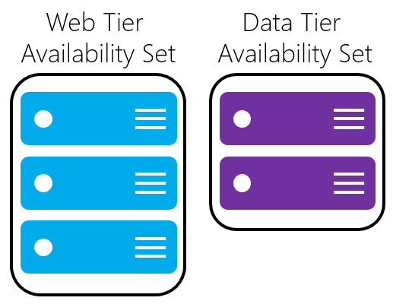
Availability Sets
Do NOT put a single VM in an Availability Set
Example - for an application,
Place front-end virtual machines in the same availability set
AND
Data-tier virtual machines in their own availability set
Notes:
Fault domain – collection of resources that may fail at the same time due to same root cause. Servers in same rack are part of same fault domain. A fault domain has a single point of failure. Place resources in separate fault domain so that they remain available in case of a failure
Update domain – logical collection of resources that can be updated at the same time. One update domain has updates applied at a time and may require rebooting. Place resources in separate update domains – it is automatic
One update domain has updates applied at a time
Availability set – can place vm’s in an availability set at creation or after deployment . Moving a vm in or out of availability set causes it to reboot

Slide 49
Availability Sets: How Do We Do It? Fault and Update Domains
Fault Domains
Represent groups of resources anticipated to fail together
i.e. Same rack, same server
Fabric spreads instances across fault at least 2 fault domains when two or more virtual machines are placed in an availability set
Update Domains
Represents groups of resources that will be updated together
Host OS updates honor service update domains
Specified in service definition
Default of 5 (up to 20)
Azure spreads role instances across Update Domains and Fault Domains

Slide 50
Virtual Machine Availability Sets Update Domains are honored by host OS updates
Fault Domain
Fault Domain
Rack
Rack
Availability Set
Virtual Machine
Virtual Machine
IIS1
IIS2
UD #2
UD #1
Availability Set
Virtual Machine
Virtual Machine
SQL1
SQL2
UD #1
UD #2

Slide 51
VM Scale Sets
High performance provisioning of 1000+ VMs
Auto-configuration at scale
Auto-scale based on schedule and resource metrics
Easy updates at scale
Simple Portal Integration
Notes:
So, VMs are great… but managing a lot of them individually can be hard. That’s where VM scale sets comes in..
The goal here is to enable management of like VMs as a group and make it easy to scale them in/out based on demand.
IMAGE IS IN LIBRARY
IF APPLICATION SUPPORTS IT, USE SCALE SETS

Slide 52
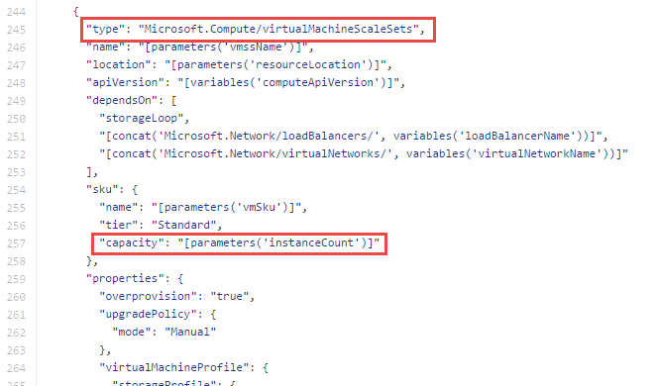
Why VM Scale Sets?
Manually scale with ‘capacity’ property
Autoscale with host metrics (MDM pipeline) or diagnostic extensions​
Small buy-in: Deploy/manage sets of 0->100 identically configured VMs ​
Guest OS patching: Patching primitives allow manually triggered rolling upgrades​​
High-availability – implicit availability set with 5 FDs/5 UDs​
Availability Sets vs Scale Sets
Avail Set: Multiple different VMs (image, size, etc); managed separately
Scale Set: Large count of the same VMs; managed together
Scale set: Reliable rapid provisioning and scale utilizing similarity of the VMs

Slide 53
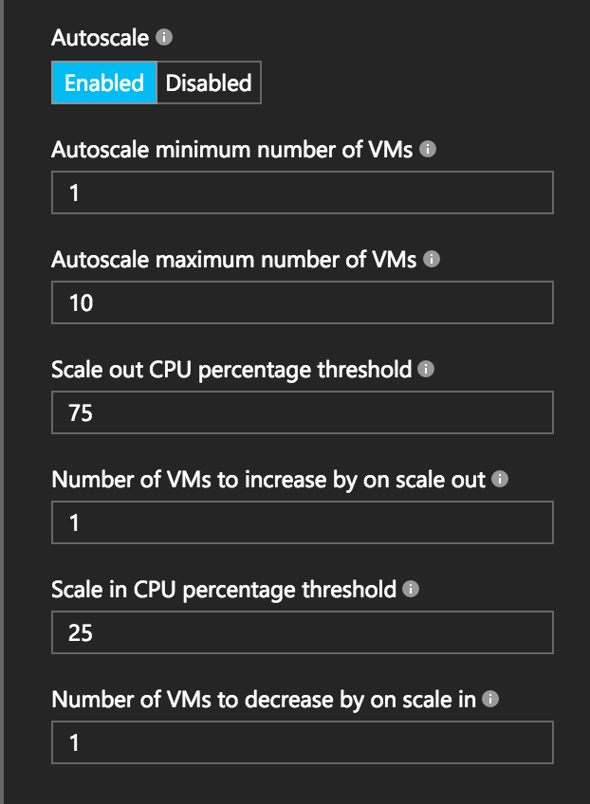
Autoscale with VM Scale Sets
Define Max – Min VMs
Define trigger and action rules
Standard audit / email notifications
Define webhooks for custom notifications and actions (e.g. runbooks)
Notes:
Metrics emitted by Azure Diagnostic Extension
Triggers can be basic performance metrics, and also schedule based, queue length based.
SERVICE FABRICS RUNS A LOT OF AZURE CAPABILITIES

Slide 54
VM scale set app deployment models
Model | When to use
Marketplace | Off the shelf solutions.
VM Extensions | Full control over app lifecycle management.
Custom data/unattend | Install custom app independently of external network.
Configuration manager | Centrally managed app installation, credentials & maintenance.
Containerized | Abstract app management from infrastructure. Cloud/DC agnostic.
Custom image | Small self-contained apps. Fast deploy. Immutable build, test, deploy pipelines.
Notes:
There are many different ways to deploy software to VM scale sets. I won’t go into any great detail here, but just to give you a flavor…
If you’re simply looking to deploy an existing application off-the-shelf, you can use the Azure marketplace
Alternatively, you can use what we call a VM extension, which is a task triggered inside the VM after the base image has booted, where you can run arbitrary scripts.
You can also deploy a custom VM image that you’ve created with a tool like Packer

Slide 55




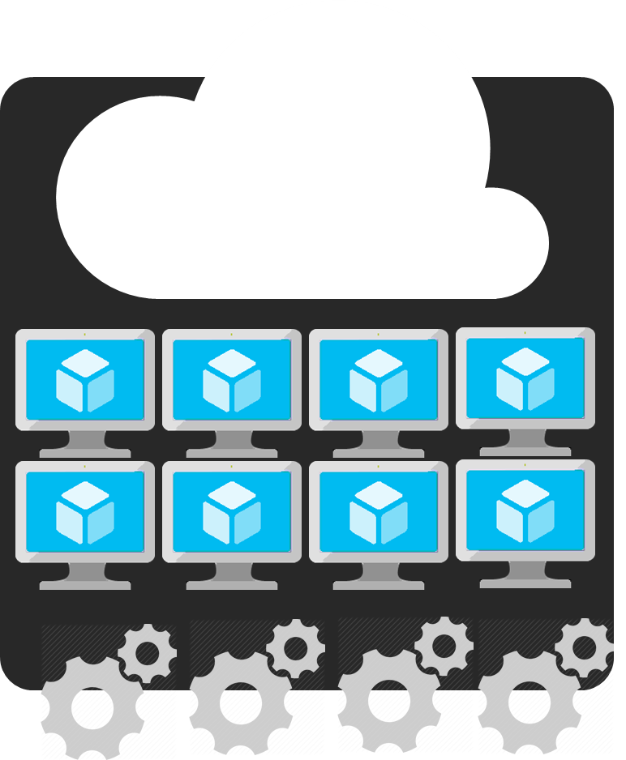
Azure Batch
APIM
Mobile apps
Logic apps
API apps
Notification hubs
Azure
functions
Compute pools for job processing
Automatic scaling and regional coverage
Linux and Windows
Automatically recover failed tasks
Input/Output handling
Low-Priority (discounted) option
Notes:
BATCH SERVICE ITSELF IS FREE. YOU PAY FOR WHAT YOU USE.
So with that little bit of context on VM scale sets, let’s start slowly moving up the stack…
While you can use VMSS directly, we expect most customers will interact with them through a higher-level abstraction.
One of those is Azure Batch, which enables highly-parallelizable job processing. You provide it with your job, configure the amount of compute you want to throw at it, and Batch will both schedule it efficiently and restart failed tasks as required.
Common scenarios include financial risk modeling, climate analysis, and media encoding

Slide 56
Create compute-intensive application
Notes:
https://azure.microsoft.com/en-us/services/batch/
https://docs.microsoft.com/en-us/azure/virtual-machines/linux/high-performance-computing

Slide 57
WHAT IS HIGH PERFORMANCE COMPUTING?
Risk Simulations
Food & beverages
Automotive
Weather forecasting
Academia
Fluid dynamics
Graphics & rendering
Banking
Oil & Gas
Defense & Aerospace
Oceaneering
Deep Learning
Crash Simulations
HPC
Insurance
Ship engineering
Pharmaceutical
Healthcare
Molecular Modelling
Structural
simulations
Genomics
Chemical engineering
Energy
Engineering & construction
Bio Science
Notes:
Before we commence with the actual pitch for HPC or High Performance Computing, I’d like to take a moment and just address a few high-level points to help position HPC within MSFT and how our strategy is currently aligned to this particular scenario.
HPC is not a solution per se, more of a way to deal with computational problems. It spans a great many industries, that each have preferred solutions or ways of using HPC depending on their area or business.
Common for HPC, whether we are in financial services or insurance calculating risk across large portfolios of policies, pricing of an instrument to calculating the airflow and dynamics or crash testing of a new car the need for massive compute power is crucial.
The very definition of HPC, is the ability to break a large computational problem into many smaller bits, and by using a cluster of computers have a massive amount of CPUs or GPUs work on the problem in parallel, outputting your results at the end.
Since HPC spans a lot of verticals and application needs, let’s take a brief look at what our strategy is.

Slide 58
Cloud value for big compute
Scale
Elasticity
Pay for use
Reach & locality
Hardware selection
No infrastructure
Known costs

Slide 59
Azure Batch Concepts
Queue
Jobs & Tasks
Applications / Algorithms
Pool of VMs
INPUT
OUTPUT
Notes:
When you have an application that runs many tasks, these tasks can be assigned to run on different computers (or virtual machines—VMs—in the case of a cloud), so that they can run in parallel. These tasks can run independently or are coupled to each other (i.e., one tasks needs another task’s results to start running or complete). Throughout the task-running process, data is read, computed and written by the tasks.

Slide 60
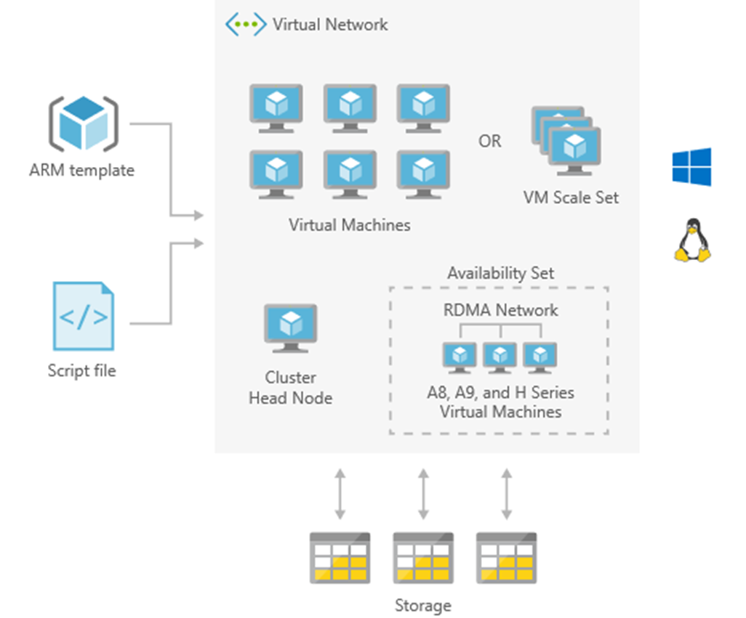
HPC cluster deployed in the cloud
Solution architecture
High performance computing (HPC) applications can scale to thousands of compute cores that run as a 100% cloud native solution. This HPC solution including the head node, compute nodes, and storage nodes, runs in Azure with no hardware infrastructure to maintain.
This solution is built on the Azure managed services: Virtual Machine Scale Sets, Virtual Network and Storage. These services run in a high-availability environment, patched and supported, allowing you to focus on your solution instead of the environment they run in.

Slide 61
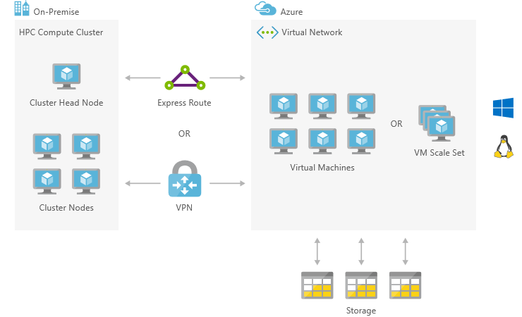
On-premises HPC implementation bursting to Azure
Solution architecture
High performance computing (HPC) applications can extend on-premises big compute. This HPC solution can extend its computational capacity by leveraging the compute-intensive instances of Virtual Machines running in Azure and accessed via Express Route or VPN.
This solution is built on the Azure managed services: Virtual Machines, Virtual Network, VPN Gateway, ExpressRoute and Storage. These services run in a high-availability environment, patched and supported, allowing you to focus on your solution instead of the environment they run in.

Slide 62
Design microservices-based solutions

Slide 63
Azure: The Power Of Choice
Application Hosting (today)
Virtual Machines
Containers
Customer-managed
(IaaS)

Slide 64
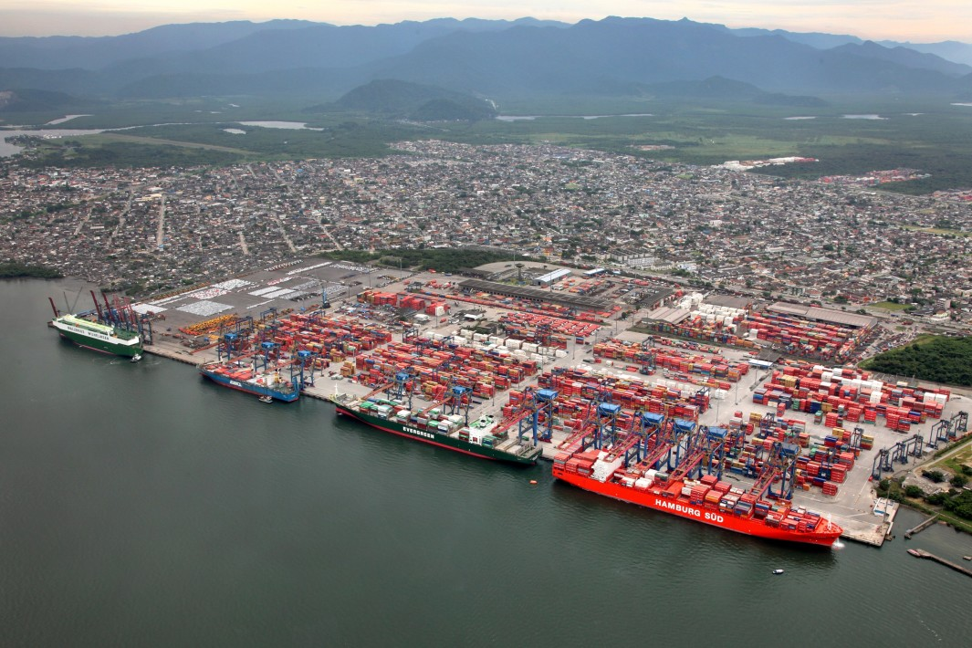
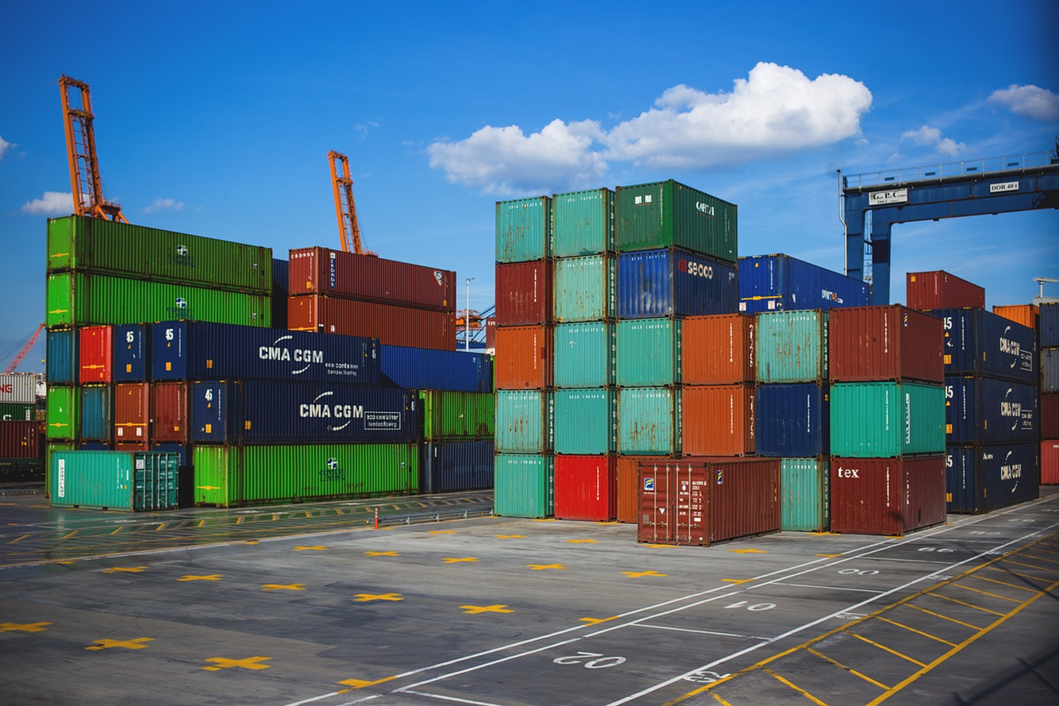
What is a Container?

Slide 65
What is a Container?
VM
VM
VM
VM
App A
App B
App C
Guest OS
Guest OS
Guest OS
Guest OS
Hypervisor
Hypervisor
Host OS
Host OS
Server
Server
Notes:
VM
Hypervisor => VMWare, HyperV
Can do turtles, all the way down till your machine feels like it’s running from a potato

Slide 66
What is a Container?
VM
VM
VM
VM
App A
App B
App C
Guest OS
Guest OS
Guest OS
Container Engine
Guest OS
Hypervisor
Hypervisor
Host OS
Host OS
Server
Server
Notes:
VM
Hypervisor => VMWare, HyperV
Can do turtles, all the way down till your machine feels like it’s running from a potato

Slide 67
What is a Container?
VM
VM
VM
VM
App A
App B
App C
Container
App A
Guest OS
Guest OS
Guest OS
Bins/Libs
Container Engine
Guest OS
Hypervisor
Hypervisor
Host OS
Host OS
Server
Server
Notes:
VM
Hypervisor => VMWare, HyperV
Can do turtles, all the way down till your machine feels like it’s running from a potato

Slide 68
What is a Container?
VM
VM
VM
VM
App A
App A
App B
Container
Container
Container
App A
App B
App C
Guest OS
Guest OS
Guest OS
Bins/Libs
Bins/Libs
Bins/Libs
Container Engine
Guest OS
Hypervisor
Hypervisor
Host OS
Host OS
Server
Server
Notes:
Containers—greater density, consistent way to package and deliver apps with minimal code changes
VMs virtualize HW creating illusion of VMs each having their own guest OS
Containers virtualize OS. Share OS and create an isolated instance of the OS for each application
Faster app start up compared to booting up a VM

Slide 69
Why?
Notes:
What benefits do you get from containers?

Slide 70
Lightweight
Notes:
From the diagram, you saw there’s less baggage.
- not spinning up new kernel for each app

Slide 71
Portable
Notes:
Guaranteed to run consistently, no matter where you depoy
Complete Isolation

Slide 72
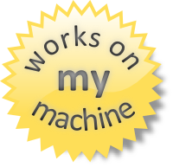
Notes:
Write Once, run anywhere

Slide 73
Ok, I’ve got containers.
Now what?

Slide 74
What is a Container Orchestrator?

Slide 75
What is a Container Orchestrator?
Container Orchestrator
VM
VM
Container
Container
Container
Container
Container
Container
App A
App B
App C
App A
App B
App C
Bins/Libs
Bins/Libs
Bins/Libs
Bins/Libs
Bins/Libs
Bins/Libs
Container Engine
Container Engine
Guest OS
Guest OS
Hypervisor
Hypervisor
Host OS
Host OS
Server
Server
Notes:
An orchestrator is to containers what a hypervisor is to VMs

Slide 76
What is a Container Orchestrator?
VM
VM
VM
Container Orchestrator
Container
Container
Container
Container
Container
Container
App A
App B
App C
App A
App B
App C
Bins/Libs
Bins/Libs
Bins/Libs
Bins/Libs
Bins/Libs
Bins/Libs
Container Engine
Container Engine
Guest OS
Guest OS
Guest OS
Hypervisor
Hypervisor
Hypervisor
Host OS
Host OS
Host OS
Server
Server
Server
Notes:
NANOSERVER 300MB COMPARED TO WS2K16 3GB
LINUX BASED CONTAINERS SUPPORTED ON WS2K16
DOCKER LICENSE INCLUDED WITH WS2K16 LICENSE
NESTED VIRTUALIZATION—RUN A HYPERVISOR IN A VM

Slide 77
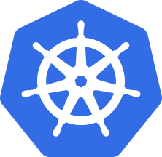
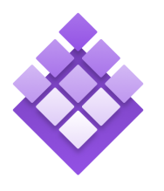

Azure Container Service
Azure Container Service
Making containers in Azure EZ!
Standard Docker tooling & API Support
Streamlined provisioning of K8S, DCOS, and Docker Swarm
Linux & Windows Server Containers
Azure & Azure Stack
ACS --> AKS (Preview)
Focus on Kubernetes
Managed Orchestrator
Kubernetes
DC/OS
Swarm
Notes:
Running alongside excitement in containers has been excitement about container orchestrators.
The core job of the orchestrator is to take your containers and deploy them within a pool of compute infrastructure, then monitor their health and resource usage as they run, restarting or load balancing them as required.
Two popular OSS orchestrators are DC/OS and Swarm. DC/OS is developed by Mesosphere and is based on the Apache Mesos scheduler, whereas Swarm is built by Docker Inc.
So what is the role of ACS relative to the orchestrators? Well, historically they’ve been a pretty big pain to set up since each has a set of specific dependencies and expects a particular topology, including the deployment of a master node alongside a set of workers. ACS provides an easy way to configure an Azure environment that covers all of that and creates an environment that incorporates a number of best practices.
One important thing to note here is that EVERYTHING is OSS. You could easily take apps running on ACS and move them to another environment without changing anything you do.

Slide 78
What is the point of all of this?!

Slide 79
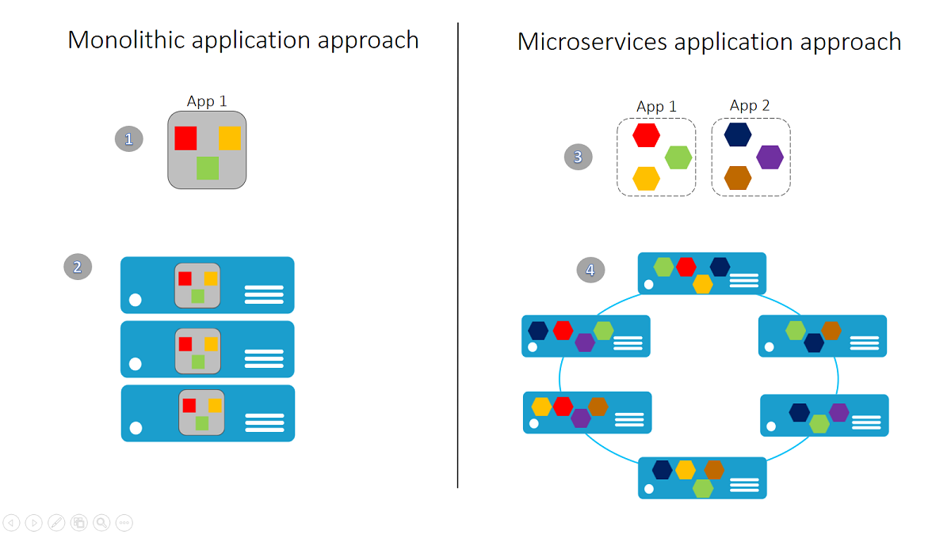
Microservices 101
Notes:
MS WANTS YOU TO MOVE FROM IAAS THROUGH PAAS TO SAAS—OFTEN A MULTI-YEAR PROCESS
A monolithic app contains domain-specific functionality and is normally divided by functional layers, such as web, business, and data.
You scale a monolithic app by cloning it on multiple servers/virtual machines/containers.
A microservice application separates functionality into separate smaller services.
The microservices approach scales out by deploying each service independently, creating instances of these services across servers/virtual machines/containers.
What is a microservice?
There are different definitions of microservices. If you search the Internet, you'll find many useful resources that provide their own viewpoints and definitions. However, most of the following characteristics of microservices are widely agreed upon:+
Encapsulate a customer or business scenario. What is the problem you are solving?
Developed by a small engineering team.
Written in any programming language and use any framework.
Consist of code and (optionally) state, both of which are independently versioned, deployed, and scaled.
Interact with other microservices over well-defined interfaces and protocols.
Have unique names (URLs) used to resolve their location.
Remain consistent and available in the presence of failures.
+
You can summarize these characteristics into:+
Microservice applications are composed of small, independently versioned, and scalable customer-focused services that communicate with each other over standard protocols with well-defined interfaces.+

Slide 80
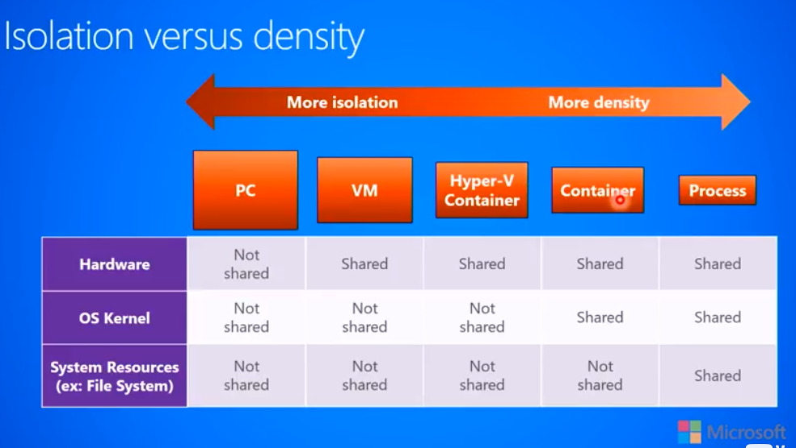
Microsoft: DEVOPS200.9x Architecting Distributed Cloud Applications

Slide 81

Azure Container Instances (Preview)
Simplest and easiest way to run individual containers in the cloud
No VM management
Per-second billing with customized resource requests
Linux and Windows Server containers
Notes:
VMS USAGE ROUNDS DOWN, I.E. 59 SECONDS ROUNDS DOWN TO 0

Slide 82
Azure: The Power Of Choice
Application Hosting (today)
Virtual Machines
Containers
Service Fabric
Customer-managed
(IaaS)
Platform-managed
(mIaaS/PaaS)

Slide 83
Microsoft Azure Service Fabric A platform for reliable, hyperscale, microservice-based applications
Microservices
Service Fabric
Container Orchestration & lifecycle management
Application Programming Models
High Availability
Hybrid Operations
Data Partitioning
Health Monitoring
Self-healing
Simple programming models
High Density
Rolling Upgrades
Low Latency
Placement Constraints
Replication & Failover
Stateful services
Fast startup & shutdown
Load balancing
Hyper-Scale
Automated Rollback
Management
Communication
Reliability
Hosting
Subsystem
Testability
Windows
Server
Linux
Windows
Server
Linux
Azure
Hosted Clouds
Federation
Windows
Server
Linux
Private Clouds
Transport
Notes:
SERVICE FABRIC NOW OPEN SOURCE
ONE OF THE OLDEST SERVICES IN AZURE--FIRST TO MARKET. Service Fabric enables you to build and manage scalable and reliable applications composed of microservices running at very high density on a shared pool of machines (commonly referred to as a Service Fabric cluster).
Powers a huge set of Microsoft Services: Azure SQL Database, Azure CosmosDB, Cortana, Power BI, Microsoft Intune, Azure Event Hubs, Skype for Business and others
It provides a sophisticated runtime for building distributed, scalable stateless and stateful microservices.
Also provides comprehensive application management capabilities for provisioning, deploying, monitoring, upgrading/patching, and deleting deployed applications.
Service Fabric is tailored to creating “born in the cloud” services that can start small, as needed, and grow to massive scale with hundreds or thousands of machines, creating Service Fabric clusters across availability sets in a region or across regions.

Slide 84
Service Fabric Microservices
A microservice is whatever you want it to be:
ASP.NET, node.js, Java VMs, an arbitrary .exe
Stateless microservices
A microservice that has state where the state is persisted to external storage, such as Azure databases or Azure storage
Stateful microservices
Reliability of state through replication and local persistence
Reduces the complexity and number of components in traditional three-tier architecture

Slide 85
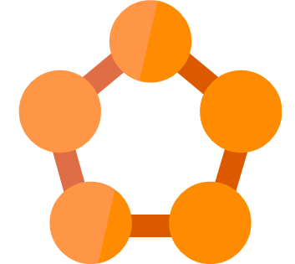

Azure Service Fabric
Hyperscale Microservices
platform
Managed platform
High productivity development
Built-in auto scale and load balancing
High availability with auto-patching
Simple
Programming models for
.NET, Java
Stateful
microservices
Highly scalable
24 X 7 availability
Health &
Monitoring
Available on
Private cloud,
Public Cloud &
Hosted Cloud
Learn easily using
Party clusters
Simple tooling with
Visual Studio,
Eclipse &
Yeoman
Windows and Linux
Container
Orchestration
DevOps and
Lifecycle management

Slide 86
Service type
Services types are composed of code/config/data packages
Code packages define an entry point (dll or exe)
Config packages define service specific config information
Data packages define static resources (eg. images)
Packages can be independently versioned
<ServiceManifest Name="QueueService" Version="1.0">
<ServiceTypes>
<StatefulServiceType ServiceTypeName="QueueServiceType" HasPersistedState="true" />
</ServiceTypes>
<CodePackage Name="Code" Version="1.0">
<EntryPoint>
<ExeHost>
<Program>ServiceHost.exe</Program>
</ExeHost>
</EntryPoint>
</CodePackage>
<ConfigPackage Name="Config" Version="1.0" />
<DataPackage Name="Data" Version="1.0" />
</ServiceManifest>
Service Type 1
Code
Config
Data

Slide 87
Application type
Declarative template for creating an application
Based on a set of service types
Used for packaging, deployment, and versioning
Application Type A
Service Type 1
Service Type 2
Service Type 3
Code
Config
Data
Code
Config
Data
Code
Config
Data

Slide 88
Design web applications
Notes:
https://docs.microsoft.com/en-us/azure/architecture/reference-architectures/app-service-web-app/

Slide 89
Azure: The Power Of Choice
Compute
Virtual Machines
Container Service
Service Fabric
App Service
More Control
Focus on the App
Customer-managed
(IaaS)
Platform-managed
(PaaS)

Slide 90
Azure App Service
Enterprise-grade apps
Fully managed platform
High productivity development
Global data center footprint
Hybrid support
Built-in auto scale and load balancing
High availability with auto-patching
.NET, Java, PHP, Node, and Python
Staging and deployment
Source code control integration
AAD integrated
Secure + compliant
Reduced operations costs
Backup and recovery
App gallery marketplace
Notes:
APP SERVICE ENVIRONMENT. UNLIKE WEB APP, YOU CAN CHOOSE SIZE AND SCALE OF YOUR ENVIRONMENT IN TERMS OF CORES, ETC
RUNS COMPUTE UNDER THE COVERS—YOU CAN CONTROL COMPUTE INFRASTRUCTURE
SHARED / DEDICATED APP SERVICE ENVIRONMENT
EVERYTHING BUILT OUT FOR YOU
NO REQUIREMENT TO USE EXPRESS ROUTE FOR THIS

Slide 91
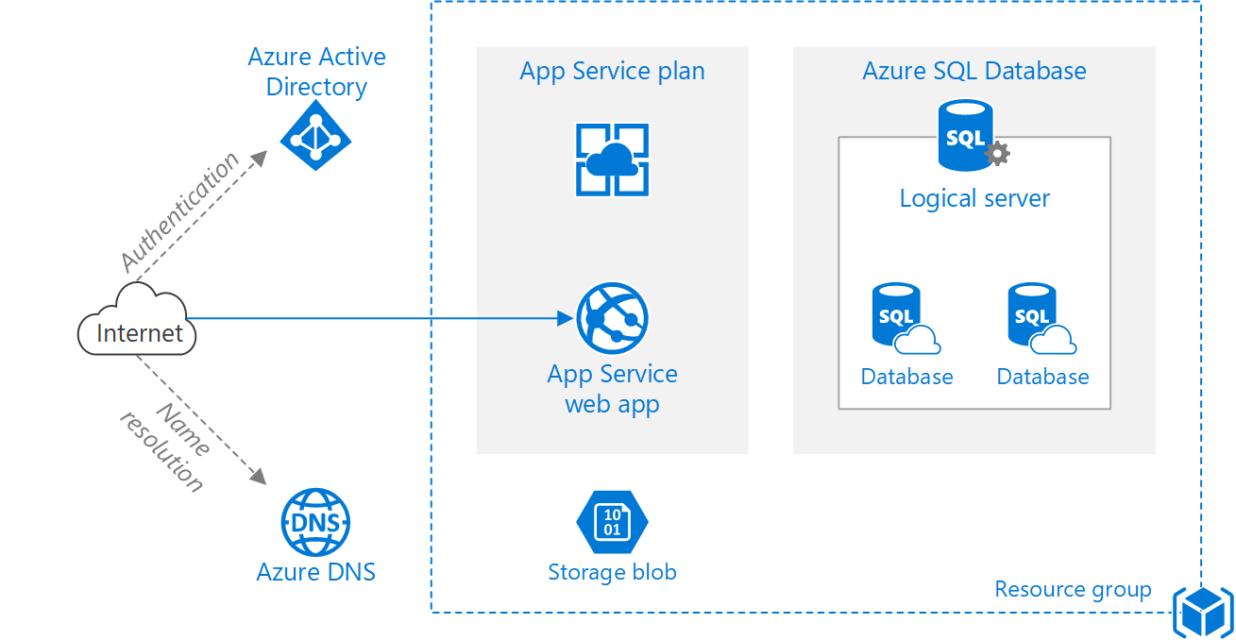
Basic
Notes:
PAAS HIDES COMPLEXITY. PASS SQL DB SHOWN.
https://docs.microsoft.com/en-us/azure/architecture/reference-architectures/app-service-web-app/basic-web-app

Slide 92
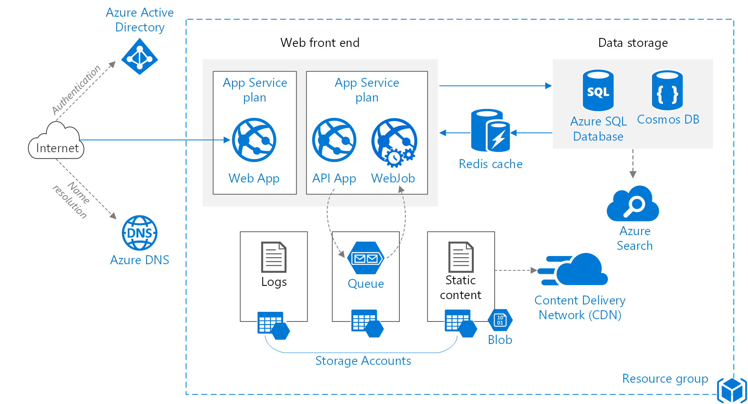
Improved Scalability
Notes:
https://docs.microsoft.com/en-us/azure/architecture/reference-architectures/app-service-web-app/scalable-web-app

Slide 93
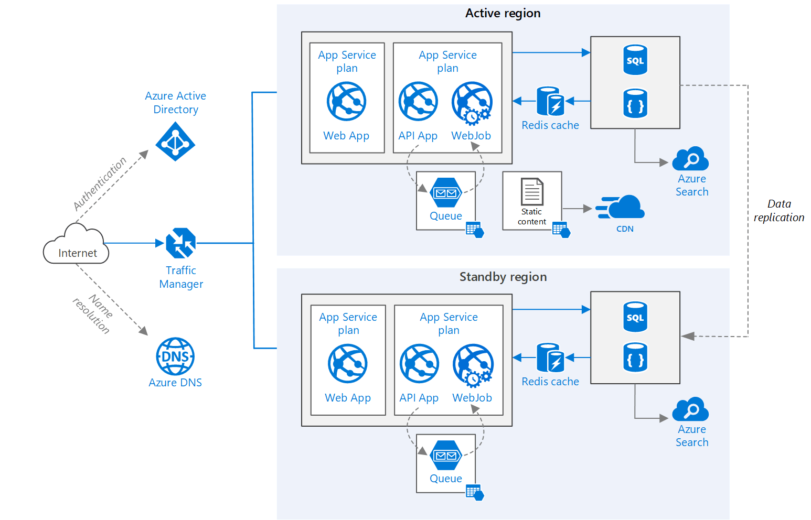
Multi-region
Notes:
https://docs.microsoft.com/en-us/azure/architecture/reference-architectures/app-service-web-app/multi-region

Slide 94

Azure API Management
Notes:
OTHER ORGS AND DEVS CAN PUBLISH OR CONNECT THROUGH YOUR APIS, E.G. EXPOSING DATA TO PARTNER ORGS
https://azure.microsoft.com/en-us/services/api-management/

Slide 95
Design solutions for serverless computing

Slide 96
Azure: The Power Of Choice
Compute
Virtual Machines
Container Service
Service Fabric
App Service
Functions
More Control
Focus on the App
Customer-managed
(IaaS)
Platform-managed
(PaaS)
Code-only
(serverless)

Slide 97
What is “serverless” and proposed Benefits
Abstraction of servers
Event-driven scale
Sub-second billing
Notes:
Abstraction of servers, infrastructure and configuration of operating system
Event-driven scale
Sub-second billing
Stateless
Serverless compute is a fully managed service. Some refer to it as Functions as a Service
OS and Framework patching is performed for you
There is zero administrative tasks and no need to manage any infrastructure
You just deploy your code (function) and it runs
Your code runs within seconds and for very short period of time
Serverless compute scales quickly (almost instantly) and vastly
Automatically scales within seconds
No scale configuration is required (there is no way to configure scale or limits)
Scales to match any given workload. Scales from zero to handle tens of thousands concurrent functions invocations within seconds
Pay only for the time your code is running
Serverless compute reacts to events
React, in near real-time, to events and triggers
Triggered by virtually any event from Azure service or 3rd party services
“Pinnacle of PaaS compute”
Not just hardware “servers”, but software servers are also managed for you
Focus on business logic, not solving technical problems not core to business
Lower effort to get started makes it easier to experiment (bots, etc.)

Slide 98
Applications
Example: Timer based processing
Eve
r
y 15 minutes
Find and clean invalid data
Clean table
Notes:
Signs that a serverless pattern might be useful for a given scenario
Stateless → Scale
Not worth deploying a traditional backend
Workload is sporadic (very low & high scale)
Dev ops favored versus dedicated ops
Lots of different services involved that need “glue”

Slide 99
Applications
Example: Azure service event processing
CSV
File added to
T
ransfo
r
m CSV to data
r
ows
P
ower BI
Blob Storage
Cha
r
t graphic

Slide 100
Applications
Example: SaaS event processing
Excel file saved
Mic
r
os
o
f
t Graph API analyzes content
C
r
eates new sheets
to OneDrive
with cha
r
ts

Slide 101
Applications
Example: Serverless Web Applications architectures
Loaded web page
C
r
eate ad based on user p
r
o
file
Completed page
calls
W
ebHook

Slide 102
Async background processing
Example: Serverless Mobile back ends
Photo taken and
Sto
r
es in blob storage
P
r
W
ebHook called
oduces scaled images

Slide 103
Applications
Example: Real-time stream processing
Millions
o
f devices feed
T
ransfo
r
m to structu
r
ed data
Sto
r
e data in
into St
r
eam Analytics
SQL Online

Slide 104
Applications
Example: Real-time bot messaging
...
?
Co
r
tana Analytics answe
r
Message sent
s questions
Chatbot sends
to Chatbot
r
esponse

Slide 105

Integration
Example: Invoice Processing
API Management
Logic App
Function
Post new invoice
Convert to JSON
Grab raw file
Store record
API layer
Fetch Invoice
Notes:
Chris

Slide 106








Azure Functions
Serverless
Accelerate development
Bind into services
Azure Service Bus
Azure Event Hub
Azure Storage
</>
Dropbox
Sendgrid
AzureDocDb
Event-driven scale
Reduced Dev Ops
Develop your way
Local development
OneDrive
Box
Twilio

Slide 107

Azure Logic Apps
Notes:
https://docs.microsoft.com/en-us/azure/logic-apps/logic-apps-what-are-logic-apps

Slide 108
Azure: The Power Of Choice
Compute
Virtual Machines
Container Service
Service Fabric
App Service
Functions
More Control
Focus on the App
Customer-managed
(IaaS)
Platform-managed
(PaaS)
Code-only
(serverless)
Notes:
Azure provides several cloud-based compute offerings to run your application so that you don't have to worry about the infrastructure details.
You can easily scale up or scale out your resources as your application usage grows. Azure offers services that cover the spectrum—from providing infrastructure-as-a-service (IaaS) to give you full control over your application hosting, through platform-as-a-service (PaaS) where the services are hosted for you, to true serverless hosting where all you need to do is write your code.

Slide 109
Summarizing the options
Service | Best used for…
VMs | Lift-and-shift for a set of “pets”
VM Scale Sets | Scaling and managing a set of identical VMs
Batch | Highly parallelized computation
Container Service | Deploying and managing a set of arbitrary Linux containers
Container Instances | Running individual containers with low overhead and no VM management
Service Fabric | Building microservice-based applications on Windows using .NET
App Service | Building standard web and mobile apps with limited management responsibilities
Functions | Building small, event-driven software with granular auto-scale

Slide 110

Questions?
Dave Burnison Dave.Burnison@Microsoft.com
Notes:
DPS DAYS INCLUDED IN MANY AZURE PLANS

Slide 111

© 2018 Microsoft Corporation. All rights reserved. Microsoft, Windows, Windows Vista and other product names are or may be registered trademarks and/or trademarks in the U.S. and/or other countries.
The information herein is for informational purposes only and represents the current view of Microsoft Corporation as of the date of this presentation. Because Microsoft must respond to changing market conditions, it should not be interpreted to be a commitment on the part of Microsoft, and Microsoft cannot guarantee the accuracy of any information provided after the date of this presentation. MICROSOFT MAKES NO WARRANTIES, EXPRESS, IMPLIED OR STATUTORY, AS TO THE INFORMATION IN THIS PRESENTATION.

Slide 112
Appendix

Slide 113
VMs – Supported Operating Systems
Linux distributions and versions supported on Azure
Linux
CentOS
CoreOS
Debian
Oracle
Red Hat
SUSE
openSUSE
Ubuntu
Windows Server
Windows 2003* https://support.microsoft.com/en-us/help/3206074
Windows 2008R2+
Distribution | Version | Drivers | Agent
CentOS | CentOS 6.3+, 7.0+ | CentOS 6.3: LIS download CentOS 6.4+: In kernel | Package: In repo under "WALinuxAgent" Source code: GitHub
CoreOS | 494.4.0+ | In kernel | Source code: GitHub
Debian | Debian 7.9+, 8.2+ | In kernel | Package: In repo under "waagent" Source code: GitHub
Oracle Linux | 6.4+, 7.0+ | In kernel | Package: In repo under "WALinuxAgent" Source code: GitHub
Red Hat Enterprise Linux | RHEL 6.7+, 7.1+ | In kernel | Package: In repo under "WALinuxAgent" Source code: GitHub
SUSE Linux Enterprise | SLES/SLES for SAP 11 SP4 12 SP1+ | In kernel | Package: for 11 in Cloud:Tools repo for 12 included in "Public Cloud" Module under "python-azure-agent" Source code: GitHub
openSUSE | openSUSE Leap 42.1+ | In kernel | Package: In Cloud:Tools repo under "python-azure-agent" Source code: GitHub
Ubuntu | Ubuntu 12.04, 14.04, 16.04, 16.10 | In kernel | Package: In repo under "walinuxagent" Source code: GitHub
Notes:
https://docs.microsoft.com/en-us/azure/virtual-machines/linux/endorsed-distros
Bring your own image for windows server 2003

Slide 114
VM Scaling
Resize VMs (Scale up or down)
Offline operation
Just a reboot if in a cluster that supports new size
Requires a deallocation if new size is not supported in the cluster (a little longer)
Scale In or Out
You can create new instances of the VM based on platform images (max 1000) or your own custom images (max 100)
Using VM Scale Sets
Using Azure Automation
Scheduled
Azure Autoscale
System Metrics (CPU, RAM, etc)
Custom Metrics
Notes:
If the VM is part of an availability set and the new size is not supported in the cluster, all VMs in the availability set will need to be deallocated for the resize to happen
https://docs.microsoft.com/en-us/azure/virtual-machines/windows/resize-vm
- Azure Autoscale
System Metrics (CPU, RAM, etc)
Custom Metrics https://docs.microsoft.com/en-us/azure/monitoring-and-diagnostics/monitoring-overview-autoscale#resource-metrics
Scale
Up/Down
In/Out

Slide 115


Virtual Machine Scale Sets
Deploy and manage VMs as a set
An Azure Compute resource Microsoft.Compute/virtualMachineScaleSets
Scale - Deploy identical resources
Easily
Rapidly
At scale.. 10s – 10,000s of cores
Low cost - Dynamically increase/decrease compute power to optimize costs
Elasticity - Automatically scale to changing demand
Notes:
https://azure.microsoft.com/en-us/documentation/services/virtual-machines-scale-sets
Design Considerations For Scale Sets
https://docs.microsoft.com/en-us/azure/virtual-machine-scale-sets/virtual-machine-scale-sets-design-overview

Slide 116
VM Disks
Disks can be resized up to 4TB
Managed Vs Unmanaged.
Encryption
Disk Caching
None – for Write only and Write heavy (SQL Logs)
ReadOnly – for Read only or read-intensive disks (SQL Data files)
ReadWrite – for Operating System disks
Notes:
Disk and Azure Storage pricing: https://azure.microsoft.com/en-us/pricing/details/storage/blobs/
Encryption: https://docs.microsoft.com/en-us/azure/security/azure-security-disk-encryption#disk-encryption-deployment-scenarios-and-user-experiences
IaaS VMs are secured at rest, because you can use industry-standard encryption technology to address organizational security and compliance requirements.
IaaS VMs boot under customer-controlled keys and policies, and you can audit their usage in your key vault.
Managed disks: https://docs.microsoft.com/en-us/azure/virtual-machines/windows/managed-disks-overview
Managed disks are encrypted by default

Slide 117
VM Disks
Images are representations of your VM that you can use to create more instances of the VM
You can capture an Image of a VM and it will include all the disks
Snapshots only capture one disk at a time.
Disk Snapshots let you capture current state copies of your disks.
Managed Disks: Take Snapshots of the disk
Unmanaged Disks: Take Snapshots of the underlying VHD blob
Notes:
You can capture an Image of a VM and it will include all the disks. https://docs.microsoft.com/en-us/azure/virtual-machines/windows/capture-image-resource
Managed Disks: Take Snapshots of the disk https://docs.microsoft.com/en-us/azure/storage/storage-managed-disks-overview#images-versus-snapshots
Unmanaged Disks: Take Snapshots of the underlying VHD blob https://docs.microsoft.com/en-us/azure/storage/storage-incremental-snapshots

Slide 118
Exam Tip - Increase size of existing Disks
You can easily increase the size of existing disks. For example, you might want to increase the size of a 30-GB disk to 128 GB, or even to 4 TB. Or, you might want to convert your P20 disk to a P30 disk because you need more capacity or more IOPS and throughput.
Notes:
https://docs.microsoft.com/en-us/azure/storage/storage-premium-storage#scalability-and-performance-targets

Slide 119
ARM Templates
Notes:
Patterns for defining complex templates -https://docs.microsoft.com/en-us/azure/azure-resource-manager/best-practices-resource-manager-design-templates

Slide 120
Azure Resource Manager (ARM)
Enable application management within Azure
Resource groups are containers that can contain multiple IaaS + PaaS resources
Support lifecycle management with integrated Role Based Access Control (RBAC)
Templatize application deployment and configuration
Supports DevOps
RESOU
R
CE G
R
OUP
Notes:
All the resources in your resource group should share the same lifecycle. You deploy, update, and delete them together. If one resource, such as a database server, needs to exist on a different deployment cycle it should be in another resource group.
Each resource can only exist in one resource group.
You can add or remove a resource to a resource group at any time.
You can move a resource from one resource group to another group. For more information, see Move resources to new resource group or subscription.
A resource group can contain resources that reside in different regions.
A resource group can be used to scope access control for administrative actions.
A resource can interact with resources in other resource groups. This interaction is common when the two resources are related but do not share the same lifecycle (for example, web apps connecting to a database).

Slide 121
Azure Resource Manager
Describe
WHERE Resource Inventory
WHAT Component Relationships
HOW Tags + links + groups
Provision
WHERE Across Regions
WHAT Across Resources
HOW In service and in guest
Control
WHO Access control
WHAT Changes
HOW RBAC

Slide 122

What is ARM?
Resource
Resource Group
Resource Provider
Resource Manager Template
Notes:
https://docs.microsoft.com/en-us/azure/azure-resource-manager/resource-group-overview
The following image shows how all the tools interact with the same Azure Resource Manager API. The API passes requests to the Resource Manager service, which authenticates and authorizes the requests. Resource Manager then routes the requests to the appropriate resource providers.
If you are new to Azure Resource Manager, there are some terms you might not be familiar with.
resource - A manageable item that is available through Azure. Some common resources are a virtual machine, storage account, web app, database, and virtual network, but there are many more.
resource group - A container that holds related resources for an Azure solution. The resource group can include all the resources for the solution, or only those resources that you want to manage as a group. You decide how you want to allocate resources to resource groups based on what makes the most sense for your organization. See Resource groups.
resource provider - A service that supplies the resources you can deploy and manage through Resource Manager. Each resource provider offers operations for working with the resources that are deployed. Some common resource providers are Microsoft.Compute, which supplies the virtual machine resource, Microsoft.Storage, which supplies the storage account resource, and Microsoft.Web, which supplies resources related to web apps. See Resource providers.
Resource Manager template - A JavaScript Object Notation (JSON) file that defines one or more resources to deploy to a resource group. It also defines the dependencies between the deployed resources. The template can be used to deploy the resources consistently and repeatedly. See Template deployment.
declarative syntax - Syntax that lets you state "Here is what I intend to create" without having to write the sequence of programming commands to create it. The Resource Manager template is an example of declarative syntax. In the file, you define the properties for the infrastructure to deploy to Azure.

Slide 123

ARM Templates - Structure
Element name | Required | Description
$schema | Yes | Location of the JSON schema file that describes the version of the template language. Use the URL shown in the preceding example.
contentVersion | Yes | Version of the template (such as 1.0.0.0). You can provide any value for this element. When deploying resources using the template, this value can be used to make sure that the right template is being used.
parameters | No | Values that are provided when deployment is executed to customize resource deployment.
variables | No | Values that are used as JSON fragments in the template to simplify template language expressions.
resources | Yes | Resource types that are deployed or updated in a resource group.
outputs | No | Values that are returned after deployment.
Notes:
https://docs.microsoft.com/en-us/azure/azure-resource-manager/resource-group-authoring-templates

Slide 124
Template Deployment Mode
Complete: Resource Manager deletes resources that exist in the resource group but are not specified in the template.
Incremental: Resource Manager leaves unchanged resources that exist in the resource group but are not specified in the template.

Slide 125
Existing Resource Group
contains:
Resource A
Resource B
Resource C
Template defines:
Resource A
Resource B
Resource D
When deployed in incremental mode, Resource C is deleted. The resource group contains:
Resource A
Resource B
Resource C
Resource D
When deployed in complete mode, Resource C is deleted. The resource group contains:
Resource A
Resource B
Resource D
To use complete mode, use the Mode parameter
Notes:
New-AzureRmResourceGroupDeployment -Mode Complete -Name ExampleDeployment ` -ResourceGroupName ExampleResourceGroup -TemplateFile c:\MyTemplates\storage.json

Slide 126

ARM Templates - Parameters
Element name | Required | Description
parameterName | Yes | Name of the parameter. Must be a valid JavaScript identifier.
type | Yes | Type of the parameter value. See the list of allowed types after this table.
defaultValue | No | Default value for the parameter, if no value is provided for the parameter.
allowedValues | No | Array of allowed values for the parameter to make sure that the right value is provided.
minValue | No | The minimum value for int type parameters, this value is inclusive.
maxValue | No | The maximum value for int type parameters, this value is inclusive.
minLength | No | The minimum length for string, secureString, and array type parameters, this value is inclusive.
maxLength | No | The maximum length for string, secureString, and array type parameters, this value is inclusive.
description | No | Description of the parameter that is displayed to users through the portal.
Allowed Types
string
secureString
int
bool
object
secureObject
array
Notes:
In the parameters section of the template, you specify which values you can input when deploying the resources. These parameter values enable you to customize the deployment by providing values that are tailored for a particular environment (such as dev, test, and production). You do not have to provide parameters in your template, but without parameters your template would always deploy the same resources with the same names, locations, and properties.

Slide 127
Re-use ARM Templates
By passing in parameters to your ARM Templates, you can re-use them in many different scenarios. You can deploy full solutions with t-shirt sizing (Small, Medium, Large) based on parameters you pass in: Size of VM, # of VMs, etc.
Be aware of what values in the ARM template need to be unique when re-using templates: https://docs.microsoft.com/en-us/azure/azure-resource-manager/resource-manager-template-best-practices#resource-names
https://docs.microsoft.com/en-us/azure/azure-resource-manager/best-practices-resource-manager-design-templates

Slide 128


ARM Templates –Variables
Use Variables for
Use variables for values that you need to use more than once in a template.
Include variables for resource names that must be unique.
Use variables for extra manipulation of parameters
You can group variables into complex objects. Use the variable.subentry format to reference a value from a complex object.
Notes:
https://docs.microsoft.com/en-us/azure/azure-resource-manager/resource-manager-template-best-practices#variables

Slide 129

ARM Templates – Functions and Expressions
Templates are JSON
Functions and Expressions extend the JSON capabilities
They let you use some coding notions inside your templates to create or evaluate dynamic values
Functions you see often:
concat – concatenates multiple values
copyIndex – returns the index of an iteration loop
resourceGroup – access properties of this resource group, like the location.
resourceId – get the unique identifier for a resource.
All Functions: https://docs.microsoft.com/en-us/azure/azure-resource-manager/resource-group-template-functions

Slide 130


ARM Templates - Dependencies
Resources may require a dependency chain; e.g. You need a VNET before you can deploy a VM.
Use “dependsOn” property to explicitly build the dependencies between resources. Resources wont get created until their dependencies are created.
Use Child resources. Only certain resources can have child resources.
Use the “reference” function to create an implicit relationship. Resources that reference another resource are created after the referenced resource.
Notes:
https://docs.microsoft.com/en-us/azure/azure-resource-manager/resource-group-define-dependencies

Slide 131
ARM Templates Advanced Topics
Creating and Updating Resources in one ARM Template based deployment: https://docs.microsoft.com/en-us/azure/azure-resource-manager/resource-manager-update
Share state between linked templates: https://docs.microsoft.com/en-us/azure/azure-resource-manager/best-practices-resource-manager-state
Patterns for deploying resources: https://docs.microsoft.com/en-us/azure/azure-resource-manager/best-practices-resource-manager-design-templates

Slide 132
Deploy Templates

Slide 133


Deploy Templates – Portal, Custom Template

Slide 134

Deploy Templates – Portal, Quickstart

Slide 135



Deploy Templates – Portal, from Account

Slide 136
ARM Role Based Access Control

Slide 137
Deploy Templates – Portal
Create resource group
Deploy resources from Marketplace
Deploy resources from custom template
Deploy resources from a template saved to your account
Next Steps
https://docs.microsoft.com/en-us/azure/azure-resource-manager/resource-group-template-deploy-portal

Slide 138

Deploy Templates - Powershell
Deploy a Template from a local json file
Deploy a Template from an external source:
Pass in a local parameter file:
Pass in an external parameter file

Slide 139

Deploy Templates - PowerShell
You can pass in parameters inline and with a local parameter file.
You CANNOT pass in parameters inline and with an external parameter file.
You can TEST a deployment before running it.
Template Deployments have 2 modes: INCREMENTAL or COMPLETE
Both modes deploy resources defined in Template.
Complete Deployment DELETES resources in group not defined in Template
Incremental does not DELETE resources not defined in Template
Use “-Mode” argument to set Mode.
Notes:
https://docs.microsoft.com/en-us/azure/azure-resource-manager/resource-group-template-deploy

Slide 140
Deploy resources with Resource Manager templates and Azure PowerShell
Deploy a template from your local machine
Deploy a template from an external source
Parameter files
Test a template deployment
Incremental and complete deployments
Sample template
Next steps
https://docs.microsoft.com/en-us/azure/azure-resource-manager/resource-group-template-deploy

Slide 141
Regional Availability

Slide 142


Regions
An Azure Region is a geographic region that contains a collection of data centers.
It’s more than one building.
Over 40 Azure regions
Special / Sovereign Regions
Notes:
An Azure Region is a geographic region that contains a collection of data centers. Datacenters will be in close geo proximity to each other – separate buildings
It’s more than one building.
There are over 36 Azure regions: https://azure.microsoft.com/en-us/regions/
Regions might have restrictions – eg. China - you might need a billing address in that country
All services might not be available in all regions
Special / Sovereign Regions:
US Gov Virginia/Iowa
China East, China North
Germany Central, Gemany Northeast

Slide 143

Regional Availability - Regions
Region Pairs
In same geography (such as US, Europe or Asia)
Replicated resources are replicated across pairs
In broad geographic outage, one region in the pair is prioritized
Data resides in the same geography as its pair (except Brazil South)
Azure Storage GRS and RA-GRS replicates data from one region to its pair.
Notes:
Datacenters are
An Azure Region is a geographic region that contains a collection of data centers.
It’s more than one building.
There are over 36 Azure regions: https://azure.microsoft.com/en-us/regions/
Special / Sovereign Regions:
US Gov Virginia/Iowa
China East, China North
Germany Central, Gemany Northeast
Region Pairs
In same geography (such as US, Europe or Asia)
Replicated resources are replicated across pairs
In broad geographic outage, one region in the pair is prioritized
Data resides in the same geography as its pair (except Brazil South)
Pairs: https://docs.microsoft.com/en-us/azure/best-practices-availability-paired-regions#what-are-paired-regions
Azure Storage GRS and RA-GRS replicates data from one region to its pair.

Slide 144

Regional Availability - Design
Primary/Secondary Region for Higher Availability
Traffic Manager routes requests
Put Primary, Secondary and Traffic Manager is separate regions
Make sure each region’s VNET IP range does not overlap
The same ARM template can be deployed, with minor parameter changes for VNET IP address space, and Resource locations.
Notes:
Microsoft Azure Traffic Manager allows you to control the distribution of user traffic for service endpoints in different datacenters. Service endpoints supported by Traffic Manager include Azure VMs, Web Apps, and cloud services. You can also use Traffic Manager with external, non-Azure endpoints.+
Traffic Manager uses the Domain Name System (DNS) to direct client requests to the most appropriate endpoint based on a traffic-routing method and the health of the endpoints. Traffic Manager provides a range of traffic-routing methods and endpoint monitoring options to suit different application needs and automatic failover models. Traffic Manager is resilient to failure, including the failure of an entire Azure region.

Slide 145
Regional Availability - Design
Configurations
Active/passive with hot standby (rec)
Active/passive with cold standby
Active/active
Use Regional Pairing
In broad outage, one region from pair is prioritized
Data residency issues mitigated
Traffic Manager
routing = priority,
health probe = write a custom service that reports accurately
Read Reference Architecture Here.
https://docs.microsoft.com/en-us/azure/architecture/reference-architectures/virtual-machines-linux/multi-region-application

Slide 146
High Availability
Availability within a region vs. Regional Availability
Azure Storage makes 3 copies of data within a region (including VM disks)
Use Availability Sets
Design loosely coupled service with asynchronous communication. Use Azure Storage queues or Azure Sevice Bus for queue-centric workflow.
Fault Detection and Retry Logic within your application
Circuit Breaker Pattern
Immutable Infrastructure, Infrastructure as Code
https://docs.microsoft.com/en-us/azure/architecture/resiliency/high-availability-azure-applications
https://docs.microsoft.com/en-us/azure/architecture/resiliency/index#designing-for-resiliency

